Slide 1
Kentucky Academy of Audiology
KAA 2019
Annual Conference
July 11-12, 2019
Embassy Suites
Lexington, KY

Slide 2
Relationships, Referrals and Resources: Best Practices in Physician Engagement
Presented By:
Robert Tysoe, Dip. Business Admin., Mktg.
Hearing Healthcare Marketing Co.,
Business Development
Sales and Marketing Training
Recruiting
Author
Professional Speaker

Slide 3
Welcome
Presenter:
Robert Tysoe, Dip., Hearing Healthcare Marketing Co.
Consultant: Business Development, Business Administration & Marketing Training
robert.tysoe@netzero.net
Ph:503 863 9250
www.audiologypracticemarketing.com

Slide 4
Industry Data
One of the top two referral sources for audiologists today are physician referrals
35% of new patient referrals are physician referrals
69% indicated that physician marketing was effective

Slide 5
Industry Data
Takes 4 – 6 conversations with the physician or key staff prior to receiving first referral
Physician referrals have a high appointment rate
Physician referrals have a higher conversion rate than any other type referral

Slide 6
Global View
Robert Tysoe, Dip. Bus Admin.
Hearing Healthcare Marketing Co.

Slide 7
Relationships, Referrals and Resources: Best Practices in Physician Engagement
OVERVIEW: Challenges and Opportunities
In 2008, The World Health Organization, Based upon the “Global Burden of Disease: 2004 Update” stated that hearing loss is the third leading cause of years lost to disability worldwide. An estimated 299 million men and 239 million women globally have “moderate or worse” hearing loss
The average age of the first time hearing aid user is between 63.3 - 74.0 years
36 % of Americans with hearing loss are below the age of 55, while 60 % are below age 65
Hearing loss represents a major public health problem. It is the third most common chronic condition in older Americans after hypertension and arthritis, and it is strongly associated with functional decline and depression. However hearing loss is substantially under-detected and under-treated. Ref: S. T. Bogardus MD et al, Screening & Mgt of Adult Hearing Loss in Primary Care. JAMA April 16 2003, Vol 289, No 15

Slide 8
Relationships, Referrals and Resources: Best Practices in Physician Engagement
OVERVIEW : Challenges and Opportunities.
US Census Bureau > 320 million US citizens. We estimate prevalence of hearing loss in individuals 12 years and older to be nearly 1 in 8 who has bilateral hearing loss, and nearly 1 in 5 who has unilateral hearing loss. Ref: Frank R. Lin MD PhD et al Johns Hopkins University. Arch Int Med/Vol Nov 14 2011.
Of the projected 48 million Americans who have a treatable loss, (>25 dB) approximately twenty percent have been treated
260,000 US Physicians influence approximately $3.0 Trillion in healthcare spending, equal to 19 % of GDP
73 % 0f the US population state they ask a primary care physician or ENT about their hearing loss first
Those clinics that do physician outreach well are generating between twenty to thirty percent of their gross revenue as a result of a physician referral. Ref: Phonak Benchmark Study 2011
PHYSICIAN REFERRALS TO AUDIOLOGY ARE THE LARGEST UNTAPPED SOURCE OF NEW AUDIOLOGY PATIENTS IN THE US AND WORLD WIDE

Slide 9
Relationships, Referrals and Resources: Best Practices in Physician Engagement.
OVERVIEW : Look to the past, find our future
In 1910, Prof. Paul Ehrlich M.D. and Dr. Sahachiro Hata developed and patented first effective antibiotic, “Salvarsan” (arsphenamine) for the treatment of syphilis. This “landmark” discovery was called a “Silver Bullet”, a chemo-therapeutic breakthrough for millions of afflicted men and women
Hoechst AG Pharmaceuticals of Germany, the company that sponsored the research on “Salvarsan” (arsphenamine) subsequently manufactured it, and thus created the foundations of mass Disease State Marketing and Relationship Marketing strategies, and implemented these large scale processes internationally in order to educate physicians about when and how to prescribe the drug

Slide 10
Relationships, Referrals and Resources: Best Practices in Physician Engagement
LOOKING AHEAD: Challenges & Opportunities. “Educate to obligate”™
What Hoechst AG pharmaceuticals accomplished with Salvarsan, (arsphenamine) in Germany and worldwide, may be easily replicated by US Audiology . We must prioritize the development of broader disease state marketing and relationship marketing strategies, provide the latest educational resources, and best practices in physician engagement that may result in enlightened, obligated physicians who can partner in the delivery of the hearing care treatment that the physician believes will provide the most effective outcome for the patient.
How does the physician benefit from a collaborative relationship with audiology?
By treating the hearing loss, and potentially reducing the 12 % incidence of related depression, (in the WHO report, unipolar depression occupied first place for years lost due to disability worldwide), both of which are barriers to care, the audiologist may indeed help to improve the physician’s pursuit of efficacy, improved quality of life , enhance the potential for decreased cost of care, and possibly improve MD clinic profitability. All of which may mean an elevated and appreciated role for audiology in both medical and public health arenas whilst serving the greater good

Slide 11
Relationships, Referrals and Resources: Best Practices in Physician Engagement
BEST PRACTICES IN PHYSICIAN ENGAGEMENT: What should I do first?
First priority is to hire/appoint a mature, personable, results oriented, problem solving person who can develop long term relationships with the receptionist, medical assistant, referral coordinator, office manager, and physician, and make “The Total Office Call” to all staff members
Create a database of primary care physicians & staff to whom you will reach out to on a monthly basis to provide scientific research articles for physicians, patient education information for nurses, and insurance and payment plan information for referral coordinators and office managers
Mail out a hand –addressed, “Lumpy Letter of Introduction” to your MD database, two to three weeks prior to your first face-to-face call
Follow up in person every 30 – 60 days and provide both classic and new research articles related to hearing loss, co-morbidities, tinnitus, balance disorders, cochlear implants, and your comprehensive list of services
Routinely send out a well written, explanatory patient report to each patient’s primary care physician
Direct mail sequenced information about you and your practice’s services every 90 Days to your database of physicians – so that you enhance brand name recognition and brand name loyalty

Slide 12
Relationships, Referrals and Resources: Best Practices in Physician Engagement
LOOKING AHEAD:
Create multi-channel marketing strategies
Understand Managed Care, Medicare & Medicaid reimbursement policies – Dr. Kim Cavitt’s Boot Camp
Implement a collaborative inter-disciplinary approach to your MD marketing process – choose physicians who have patients in common with your practice, eg endocrinologists, cardiologists, internists, nephrologists, podiatrists, ophthalmologists, neurologists, pediatricians, geriatricians, ear,nose,throat

Slide 13
Relationships, Referrals and Resources: Best Practices in Physician Engagement
“Hearing Care Access? Focus on Clinical Services, Not Devices”. Ref. Nicholas S. Reed, AuD et al Johns Hopkins University Bloomberg School of Public Health, JAMA online September 13 2018
Build a new pipeline of knowledge-based products, and new services-based products. Eg Liz Rogers, AuD – Corbin, Kentucky – newborn to geriatric, pediatric specialist, cochlear implant mapping, ear wax removal specialist etc
Embrace new outcomes based co-morbidity research and share it with our peers, physicians, the public, and patients. Eg the co-morbidity’s of dementia, obesity, nicotine addiction, cardiovascular disease, diabetes
Add new Staff and/or new Practice Partner, Physician Liaison, Speech Pathologist, Psychologist, Ophthalmologist; improve economies of scale, cross refer patients in common, practice interdisciplinary care
Collaborate not compete - develop a 24/7 answering service; and on-call cycle with other audiology providers
Collaborate not compete – develop a “Plan ‘B’ Option” relationship with your ENT’s, that has benefits for both practices and the patient
LOOKING AHEAD:
Services Marketing

Slide 14
A DISEASE STATE MARKETING SCHEDULE

Slide 15
Relationships, Referrals and Resources: Best Practices in Physician Engagement
Audiology’s calls to action:
Increased efforts to strengthen cross-disciplinary training of individuals in both the hearing sciences and public health are needed to advance research and to support broad-based public information campaigns to educate consumers.
In turn, developing strategies to promote core competencies among primary care physicians in how to address hearing loss is critical so patient concerns about hearing that are expressed at primary care visits can be acted upon. Ref: Frank R. Lin MD et al. Jama August 23/30 2016 Vol 316, Number 8

Slide 16
Relationships, Referrals and Resources: Best Practices in Physician Engagement
Why you will succeed:
Commitment and Consistency are hallmarks of integrity. “Integrity” – Stephen L. Carter Ph D.1996
“I’ve missed more than 9000 shots in my career. I’ve lost almost 300 games. 26 times I’ve been trusted to take the game-winning shot and missed. I’ve failed over and over and over again in my life. And that is why I succeed”. – Michael Jordan
“Fall seven times. Stand up eight”. Anonymous Japanese proverb
Thank you for your kind attention, Bob Tysoe, Marketing & Training, Hearing Healthcare Marketing Company, King City, OR 503 863 9250. robert.tysoe@netzero.net, www.audiologypracticemarketing.com

Slide 17
Success & Lessons Learned
Maryann McCullough Nikander, Au.D., Audiology and Hearing Aid Center in Warminster, PA

Slide 18
Maryann McCullough Nikander, AuD.
Holli Lish, AuD

Slide 19
Physician Marketing is a process….
Key
Key to marketing is identifying which physicians you plan to target
Choose
Choose someone to market for your practice who represents you and your practice well
Plan on
Plan on making an initial contact with the hope of then scheduling a short lunch or breakfast with physicians and staff
Follow up
Follow up at specific intervals and provide new information on co-morbidities, new technology, etc.
Don’t become
Don’t become discouraged – circle back and establish relationships with the physicians, physicians’ assistants, staff and office managers

Slide 20
What do we bring?

Slide 21
What’s inside that folder?

Slide 22
Examples of brochures included at follow up visits

Slide 23
Inside those brochures….

Slide 24
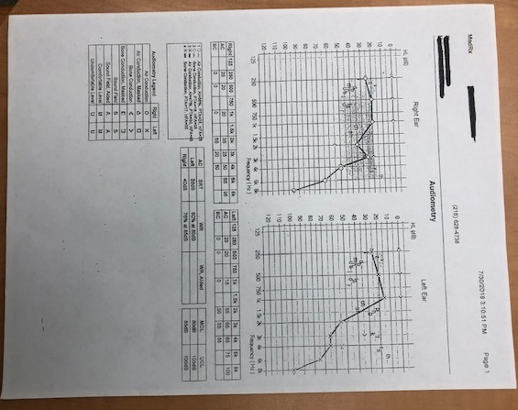
Follow up with the physician is key…. What NOT to send after patient is evaluated….a poorly written report….

Slide 25
What our physicians want to see…. A well written report with detailed history, results and recommendations

Slide 26
A Practice Approach
Stacy O’Brien, Au.D.,
Nicole Pavol,
Atlantic Hearing Balance & Tinnitus Center

Slide 27
Atlantic Hearing, Balance, & Tinnitus Center
Physician Marketing & Outreach Prep Work & Documentation

Slide 28
Physician Referral Folders

Slide 29
Thank the Physicians’ offices for their time!
Thank you for helping us GROW!

Slide 30
Have fun with the holidays!
Thank you for letting us get to know you S’more!!!

Slide 31
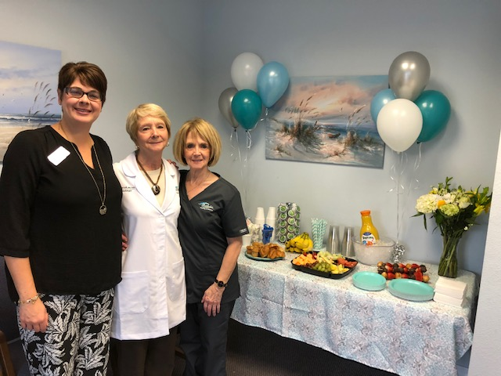
Creating a main gift with our brand that can be used for many things over and over again
Our logo printed mason jar cups go out as a gift to everyone!
They can be filled with candy, HEARING PROTECTION, hot cocoa during the holidays, etc.
We use them for Physician Marketing, Demo Days, Door Prizes, etc.
They are useful and can be seen everywhere and anywhere!

Slide 32
How do you measure success?
Identifying Targets
Territory
Plan of Action

Slide 33
4 Itineraries
Port Orange- Home Base
Daytona Beach
New Smyrna Beach/ Edgewater
Ormond Beach/Palm Coast
Rotating every 90 days with new information & content within a 40 mile radius

Slide 34
Lunch and Learns
Try to take the first available appointment but also make it work with your schedule.
Find out how many people are on staff, if they have any food allergies, how long their lunches run (some are on block schedules and you may get to see multiple physicians, but you need to know when they will be in and how long to block yourself out for).
Bring back more information to the Lunch and Learn, as you are more than likely going to give it directly to the physician.

Slide 35
Reaching out to the community
Become members with the Chamber of Commerce, Rotary, and anything else you see as an asset to the community.
Health Fairs and Lifestyle Events.
Get involved with all local Assisted Living Facilities to help facilitate all of their cleaning, hearing, balance, and tinnitus needs. A lot of physician’s are in these ALF’s as well.
Promote healthy hearing through outlets like social media marketing, Facebook, Instagram, your website, radio, the newspaper, the yellow pages, and of course by word of mouth & testimonials!

Slide 36
Marketing Categories | New Patients Seen
Physicians Marketing | 63
Friend/Family Member and Self Referrals | 13
Online | 1
Florida Health Care | 1
Newsletter | 0
Yellow Pages | 0
Doctor Presentations | 0

Slide 37
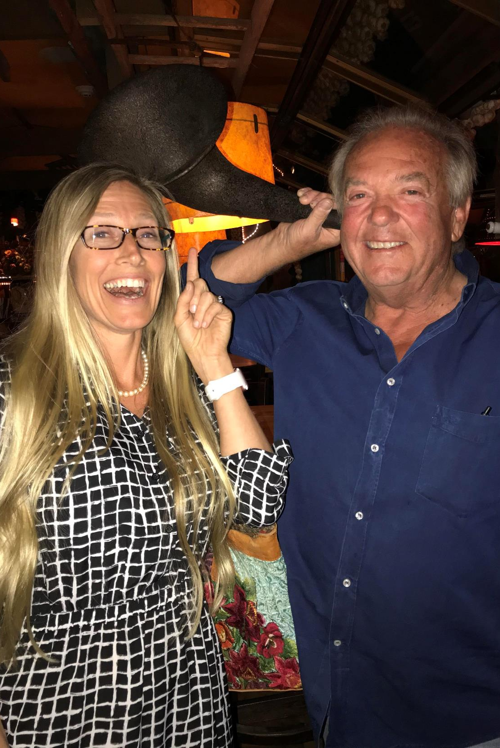
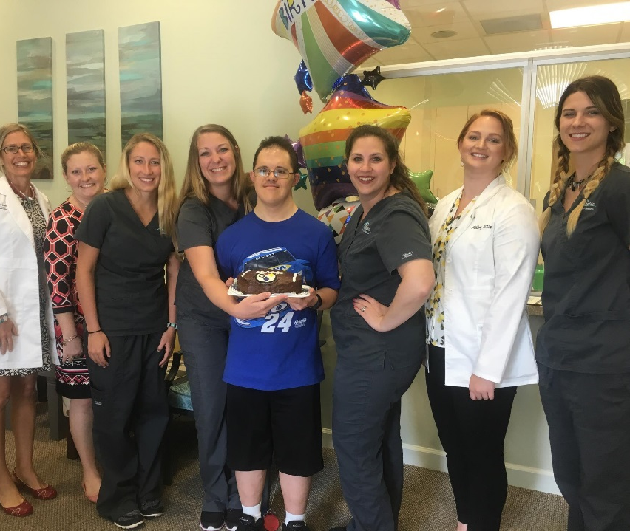
Be Yourself & have fun with it! They will see your passion for the patients & entrust their patients with you!

Slide 38
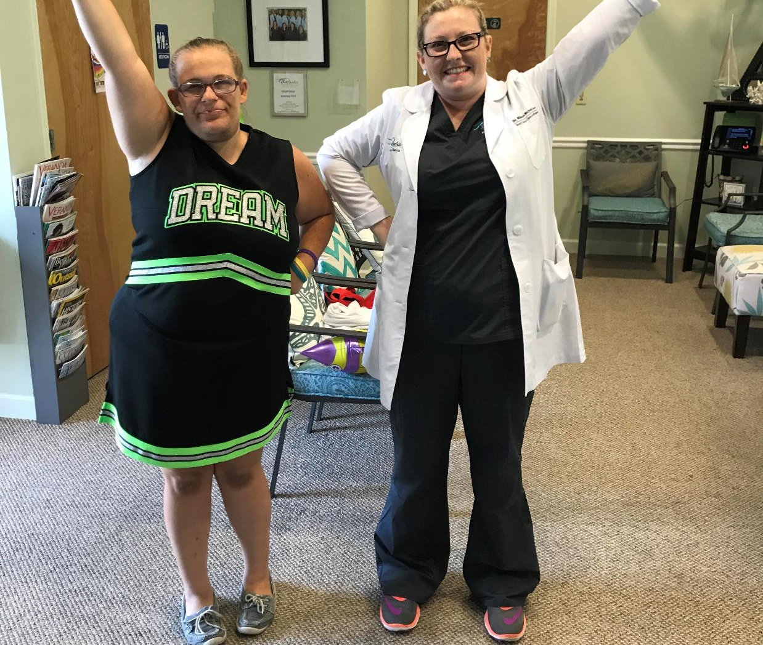
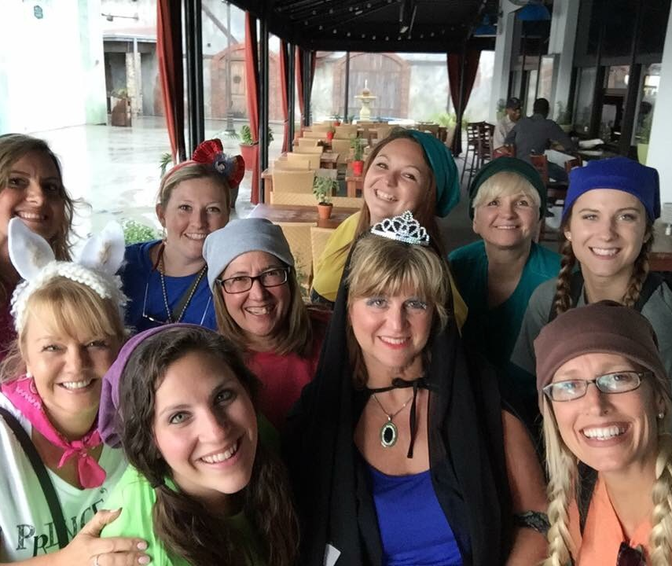
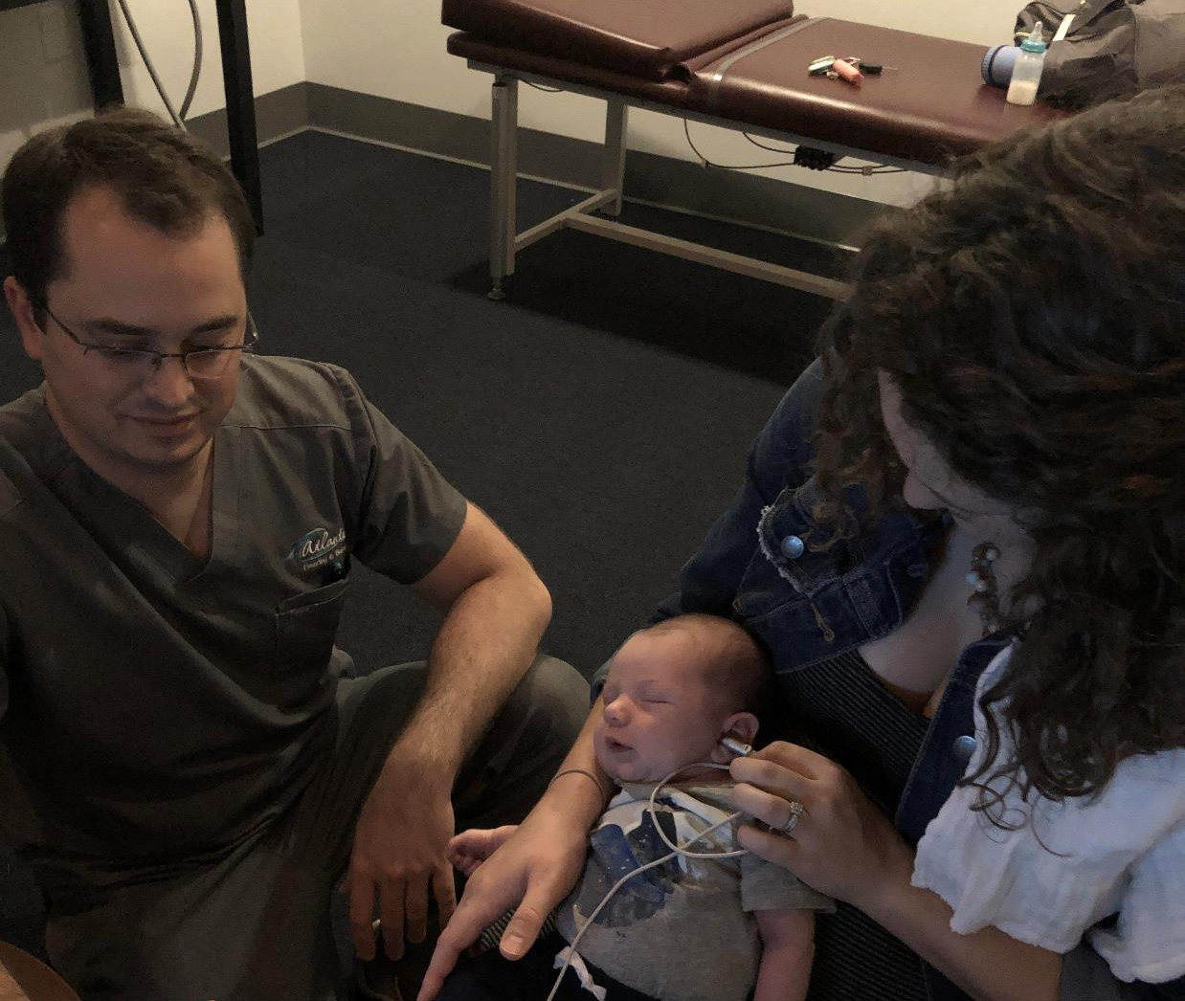
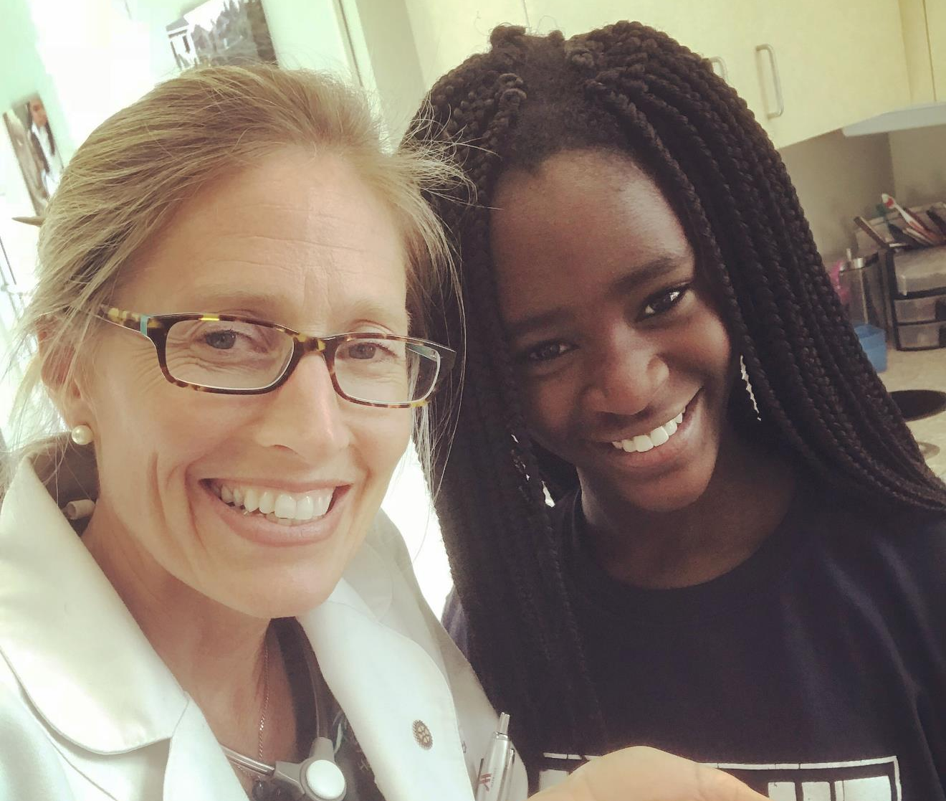
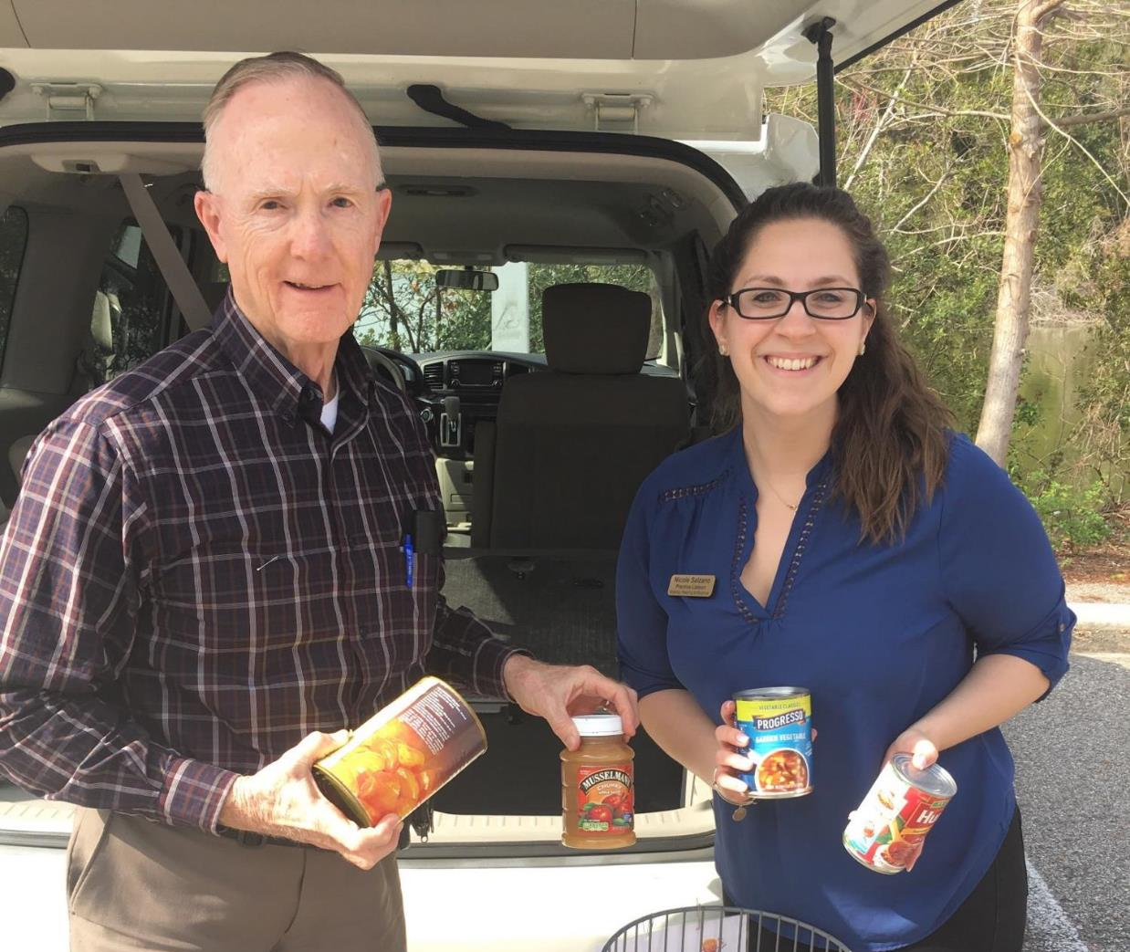
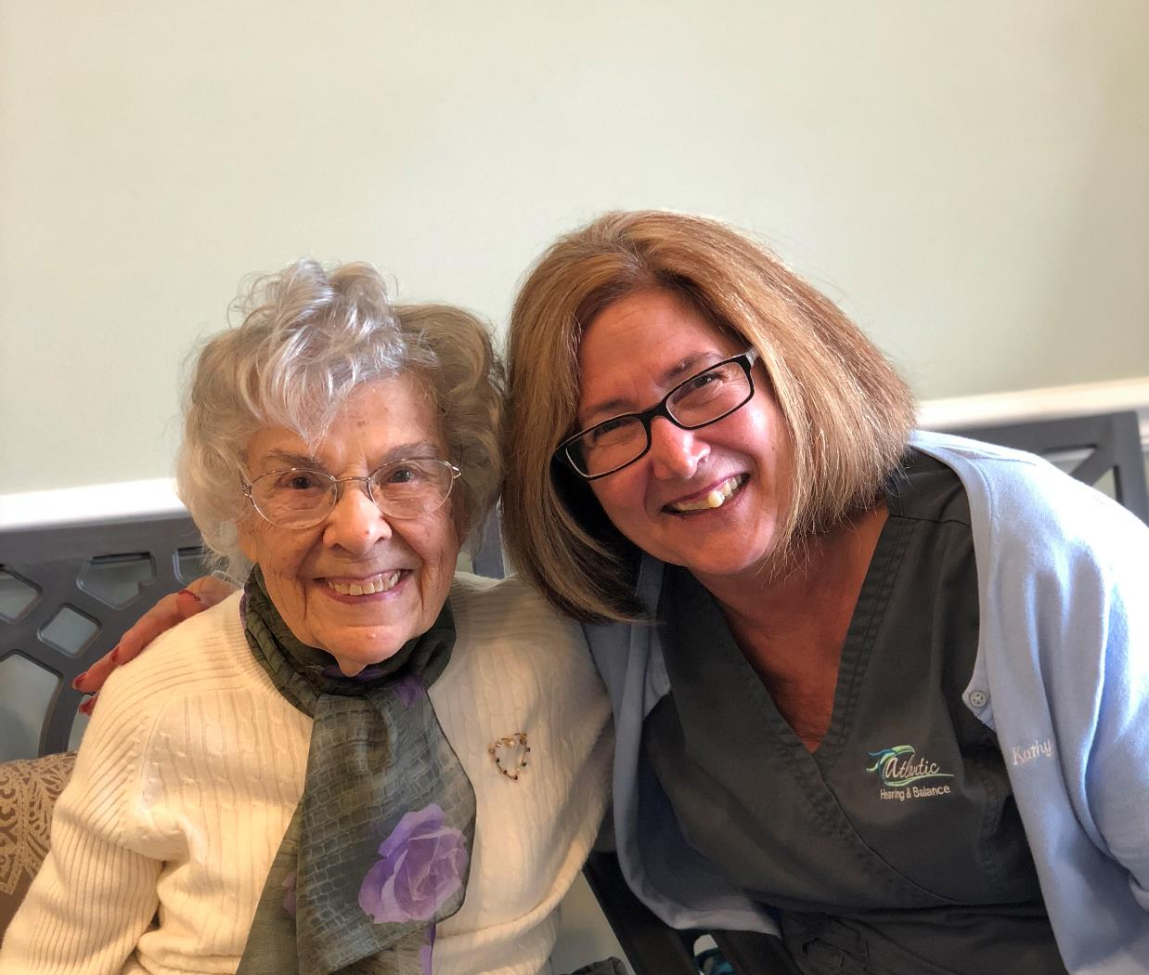

Slide 39
What do physicians want to know?
John Bakke, MBA. M.D.
Internal Medicine Specialist
Senior Healthcare Consultant
Zolo Healthcare Solutions

Slide 40
What is your criteria for adding a provider (or an Audiology provider) to your referral network?
Attributes that are necessary would be competence, integrity, and compassion. The patient expects the same high standards with regard to communication which is crucial. Most physicians, even those who have little control over the referral process, would undoubtedly value assurances that their patients will be receiving care of exceptional quality with regard to diagnostic acumen, therapeutic choice, or strategic execution.
Access is often central with physicians referring patients to specialists with the first available appointment. In the USA audiologic care is considered elective medicine. Self referral is the norm on the part of the patient. More and more patients are asking their primary care provider for guidance about care for hearing loss, tinnitus and balance disorders. This may be a reflection of any combination of our increasing population age, noise pollution, and competition amongst audiology providers/technology. Ref: Selecting a Specialist. JAMA November 12, 2014 VOL 312 Number 18. Dept. Med. Brigham and Womens Hosp and Harvard Medical School, Boston Mass.

Slide 41
How do you as a physician measure patient outcomes from a referral provider (documentation, patient feedback etc.).
Outcomes are crucial. For audiology, we rely on patient satisfaction feedback and a quality patient report. Primary Care physicians are increasingly aware that the prevention, diagnosis, treatment and follow up for mild to moderate hearing loss and is a medically relevant condition that needs evaluation and when appropriate, specialized treatment.
Referrals by physicians is becoming more organized and data driven as more systems become available, and payers are looking at data to drive quality of care and lower costs.
Patient compliance with referrals is being more actively monitored by physicians and care co-ordinators. This includes measures of patient satisfaction with services provided by specialists. Ref: J.N. Bakke, MD.

Slide 42
What is it you would like to see from a referral provider?
Since patient compliance is a function of patient engagement, enormous efforts are being made by medical payers and providers to improve patient engagement; increased engagement by patients will also drive more patient volume to hearing healthcare providers. Ref. J.N. Bakke MD.

Slide 43
Do you prefer to be consistently updated by the audiologist on new research/technology/etc. regarding audiology/hearing devices/tinnitus/vertigo/etc.?
I would love updates on evidence based research on the advances in the hearing healthcare industry, and also improvements with technology. I’d like to be kept abreast of prices and value of hearing devices. As we are all aware, our older population is growing larger and poorer. The percentage of retiree aged people who cannot afford to retire is skyrocketing so competitive options to treat hearing loss is a HUGE appeal for primary providers.

Slide 44
Before you developed a relationship with an audiologist, what were your thoughts on hearing loss/tinnitus/hearing devices/etc.?
I sent patients to one person I know who is honest and knowledgeable. She practices too far away for most people so I told them, sadly, to do their homework and shop around. I didn’t know where to send them.
Hearing healthcare providers who provide primary care providers with efficient, high quality care for referred patients, along with high satisfaction levels from those patients , will be included in larger and larger referral networks. Hearing healthcare providers will enjoy increased prosperity as a result. Ref. J.N. Bakke MD.

Slide 45
Any additional comments/suggestions you would like to give:
Offer pre and post objective tests with background noise and real life sound situations. I clearly see how the standard audiogram measurements in a soundproof environment is essential. It would be great to test with prescribed devices in simulated “real life” situations. Thankfully, Audiology is working to accomplish this.

Slide 46
Panel Questions

Slide 47
What do You Estimate is the Cost for Physician Marketing?

Slide 48
What are the advantages of using an outside agency or doing it yourself or employee

Slide 49
How do you establish your physician targets, and what specialties do you include?

Slide 50
How many physicians should you target?

Slide 51
Questions

Slide 52
Kentucky Academy of Audiology
KAA 2019
Annual Conference
Thank you sincerely for your attendance
Bob Tysoe – Hearing Healthcare Marketing Co.,
www.audiologypracticemarketing.com

