Slide 1


Tracy Brewer MSSW
Audiology and Dementia

Slide 2

Facts about dementia

Slide 3
facts
5.8 million people in the United States are living with Alzheimer’s disease and other forms of dementia
Dementia is NOT a normal part of aging- It is caused by diseases of the brain that influence memory, thinking, emotion and behavior
Alzheimer’s disease is the most common cause of dementia
Alzheimer’s is a disease that causes dementia

Slide 4

The Dementia umbrella

Slide 5
Dementia
Irreversible:
Alzheimer’s disease
Multi-infarct or vascular
Parkinson’s disease
Frontotemporal
Lewy Body disease
Huntington’s disease
Creutzfeld-Jacob disease
Reversible:
Depression
Malnutrition
Infection
Hydrocephalus
Medication/drug interaction
Vitamin B12 deficiencies
Hypoglycemia/hyperglycemia
Bell, V. and Troxel, D. (2001) The Best Friends Staff, Baltimore: Health Professions Press.

Slide 6
Signs and symptoms of dementia

Slide 7
Signs and symptoms
Memory loss that disrupts daily life
Challenges in planning or solving problems
Difficulty completing familiar tasks
Confusion with time or place
Trouble with visual or special relations
New problems with words in speaking or writing
Misplacing things and losing the ability to retrace steps
Decreased or poor judgment
Withdrawal from work or social activities
Changes in mood or personality

Slide 8

Communicating and relating

Slide 9
Feelings associated with dementia
Loss
Isolation and Loneliness
Sadness
Confusion
Worry and Anxiety
Frustration
Fear and Paranoia
Anger
Embarrassment

Slide 10
Tips to turn these feelings around
Turn paranoia into a trusting relationship
Listen
Help fill in the blanks without stepping on their toes
Do not assume a supervisory role
Pay attention to non-verbal communication
Encourage participation in communication- do not just speak to their caregiver
Share a compliment
Ask for their opinion

Slide 11
Turn around tips cont…
If something goes wrong, take the blame
Keep your language simple
Watch your body language
Watch their body language
Do not try to argue or correct them
Do not give orders
Do not try to explain too much too far in advance
Ask easily answered questions, but not too many

Slide 12

Reactive behaviors

Slide 13
Reactive behaviors in persons with dementia are a form of expression. It is their way of telling us something
We cause 90% of behaviors and spend 90% of our time trying to find the cause
To provide the best care, we need to determine what they are trying to tell us

Slide 14
Possible reasons for behaviors
Health
Environment
Task-related
Communication difficulties
Perception of reality

Slide 15
health reasons
Impaired hearing
Impaired vision
Illness (UTI, cold, flu, Covid)
Toothache
Constipation
Dehydration
Depression
Other underlying chronic illness

Slide 16
Environmental reasons
Space too big
Lighting
Poor visual orientation
Sounds
Temperature
Lack of structured routine

Slide 17
Task-related reasons
The task is now too complicated
Instructions are not given in a way that works for the person at the time
The person is not familiar with the task and fears doing something new
A familiar task is now confusing

Slide 18
Communication related reasons
Talking too fast
Arguing or confronting
Not talking to the person directly
Speaking too loud or too soft

Slide 19
Perception of reality
Delusions
Hallucinations
Is it a problem?
Who’s problem is it?

Slide 20

How to make a difference

Slide 21
Tips
Know the persons life story
Weave bits of their life story into conversation
If there is a specific staff member they connect with, have them involved in care
Brainstorm approaches. Look at what has worked and what has not in the past
Avoid labeling
Avoid Overmedicating

Slide 22
Takeaways
Dementia and audiology

Slide 23
Try to remember…
HAVE EMPATHY- How would you feel if…
When you know ONE person with dementia, you know ONE person with dementia
Keep in mind, we don’t know how much they are processing, so chose your language accordingly
BOTTOM LINE:
They are a person with a life story
The disease does not define them
Maintain their dignity
Make them feel valued

Slide 24
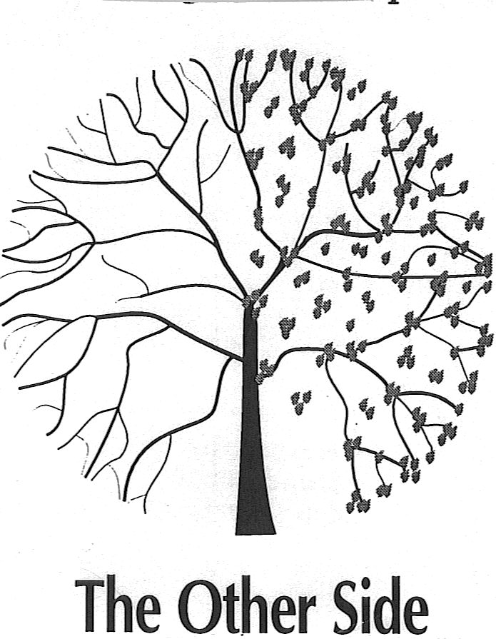
It’s not all about what they have lost, it’s about what they have left!
    The Best Friends Approach to Alzheimer’s Care, by Virginia Bell ad David Troxel.
    Copyright 1997, by Health Professions Press, Inc., Baltimore

Slide 25
References
Alzheimer’s Association
Alzheimer’s Disease International
Centers for Disease Control and Prevention
Bell, V., Troxel, D. (2012). A Dignified Life; The Best Friends Approach to Alzheimer’s Care. Health Communications, Inc.
“It is better to know the patient who has the disease than to know the patient’s disease” Hippocrates

