Slide 1
Day in the life of a tinnitus specialist
Jason Leyendecker, AuD

Slide 2
Disclaimers
Owner/manager of Audiology Concepts LLC and The Tinnitus and Hyperacusis Clinic of Minnesota
Past president of the Minnesota Academy of Audiology
President Elect of the Academy of Doctors of Audiology
Advisory Board member for Neuromod Devices

Slide 3
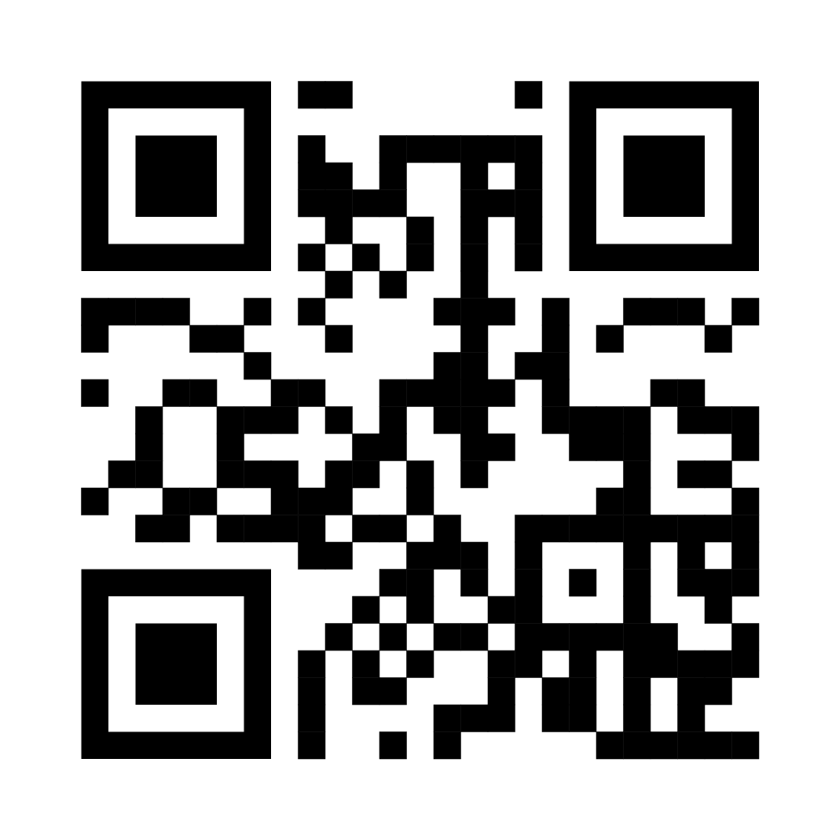
ADA Updateses
Medicare Audiology Access Improvement Act (S. 2377) reintroduced with strong bi-partisan support.
Direct Access to audiologists for Medicare Part B beneficiaries
Audiologists classified as Medicare practitioners
Reimbursement for Medicare-covered treatment services that the audiologist is licensed to provide.
Attend today’s advocacy session to learn more.

Slide 4
ADA Updateses
ADA recently launched Vestibular Special Interest Group (SIG) for audiologists who provide or are interested in providing vestibular services.
KAA attendees have access to ADA’s 2022 suite of conference recordings/presentations and may claim up to 4 hours of CE credit (free) between now and December 31st.
AuDacity Conference November 2-5 in Bonita Springs, Florida. KAA members can get $200 off using code AUD2023-KAA.

Slide 5
Why the need for more tinnitus providers?
25 million people dealing with tinnitus on any given day
48 providers listed on the ATA.org website within 1000 Miles of my home zip code
Tinnitus is a symptom of hearing loss
Everyone deserves the highest quality of life
More providers will put less of a workload on those who do it

Slide 6
Why not to do Tinnitus Management
Time consuming
Not enough treatment options
Suicidal patients
There is already a tinnitus provider near by
Not enough patients to get good at it
I’ve never done it before
Notes:
CDC.Gov/
Adults 75 and older have one of the highest suicide rates a 20.3 per 100,000 people. Men aged 75 and older have the highest rate at 42.2 per 100,000.

Slide 7
Preparation
Schooling
Training
Establish a mentor
Create a method to demystify
Create a protocol
Establish a network of healthcare providers
Notes:
Wide range of tinnitus education in our audiology curriculum
Outside tinnitus trainings available. TRT, TAT, PTM,

Slide 8
Tinnitus Trainings
Tinnitus Retraining Therapy
Tinnitus Activities Treatment
Progressive Tinnitus management
ABA Tinnitus Certificate- CH-TM
Salus University- Online 1.5 CEU Tinnitus Class

Slide 9
Initial appointment
Case history
Patient education
Audiological evaluation
Tinnitus evaluation
Audiogram explanation
Tinnitus treatment demo
Notes:
Medical case history, Legal case history, When it started, when it became bothersome, What have you tried, what worked, what hasn’t, who have you seen, What is your main objective, What bothers you the most, Tinnitus, Hyperacusis, Hearing loss. Noise history, ototoxic history, what is their journey so far.

Slide 10
What to expect in an appointment
Type A personality (Awesome Personality)
Age range typically 20-60
Long story- they have been down a path trying many things
Emotional
They have only been told bad things
Willingness to change
Family cares but doesn’t know how to help
Mixed feelings about counseling as an option
Suicidal thoughts are minimal but do happen

Slide 11
Questionnaires
TFI- Tinnitus Functional Index
TRQ- Tinnitus Reaction Questionnaire
THI- Tinnitus Handicap Questionnaire
MAQ- Misophonia Assessment Questionnaire
HQ- Hyperacusis Questionnaire
Anxiety and Depression scales
PHQ-9
GAD-7
Burns Anxiety Inventory- 11+ refer
Burns Depression Inventory- 11+ refer
Case history forms

Slide 12
Audiometric evaluation
Air/Bone- Air through 12500 Hz maybe more if still getting good thresholds out through 18k
Speech Reception Threshold
Word Recognition
UCLs using speech binaurally
Quick Sin If Hearing loss and UCLs are able to accommodate
Pitch and loudness match
Minimum masking level
Residual inhibition
UCLs for tones through 12500 or what we are able to accommodate acoustically

Slide 13
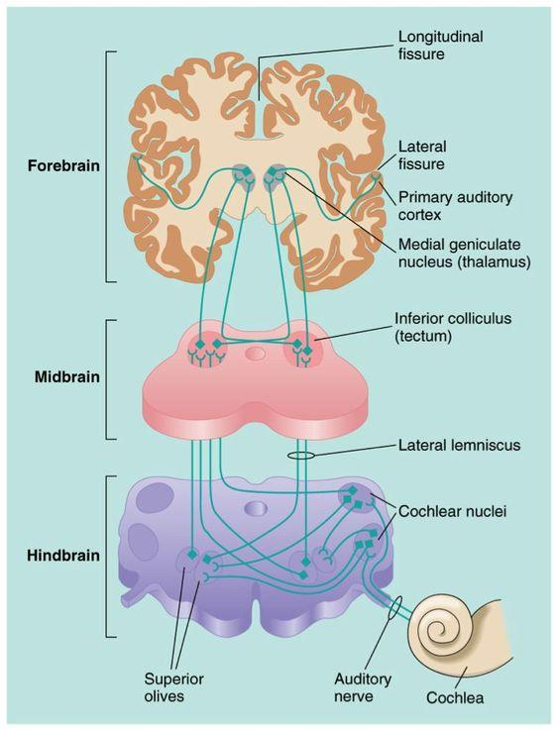
2. Limbic System
1. Dorsal Cochlear Nucleus
Notes:
https://www.ncbi.nlm.nih.gov/pmc/articles/PMC3402636/ (tinnitus and the dorsal cochlear nucleus)
https://pubs.asha.org/doi/full/10.1044/1059-0889%282008/08-0004%29

Slide 14
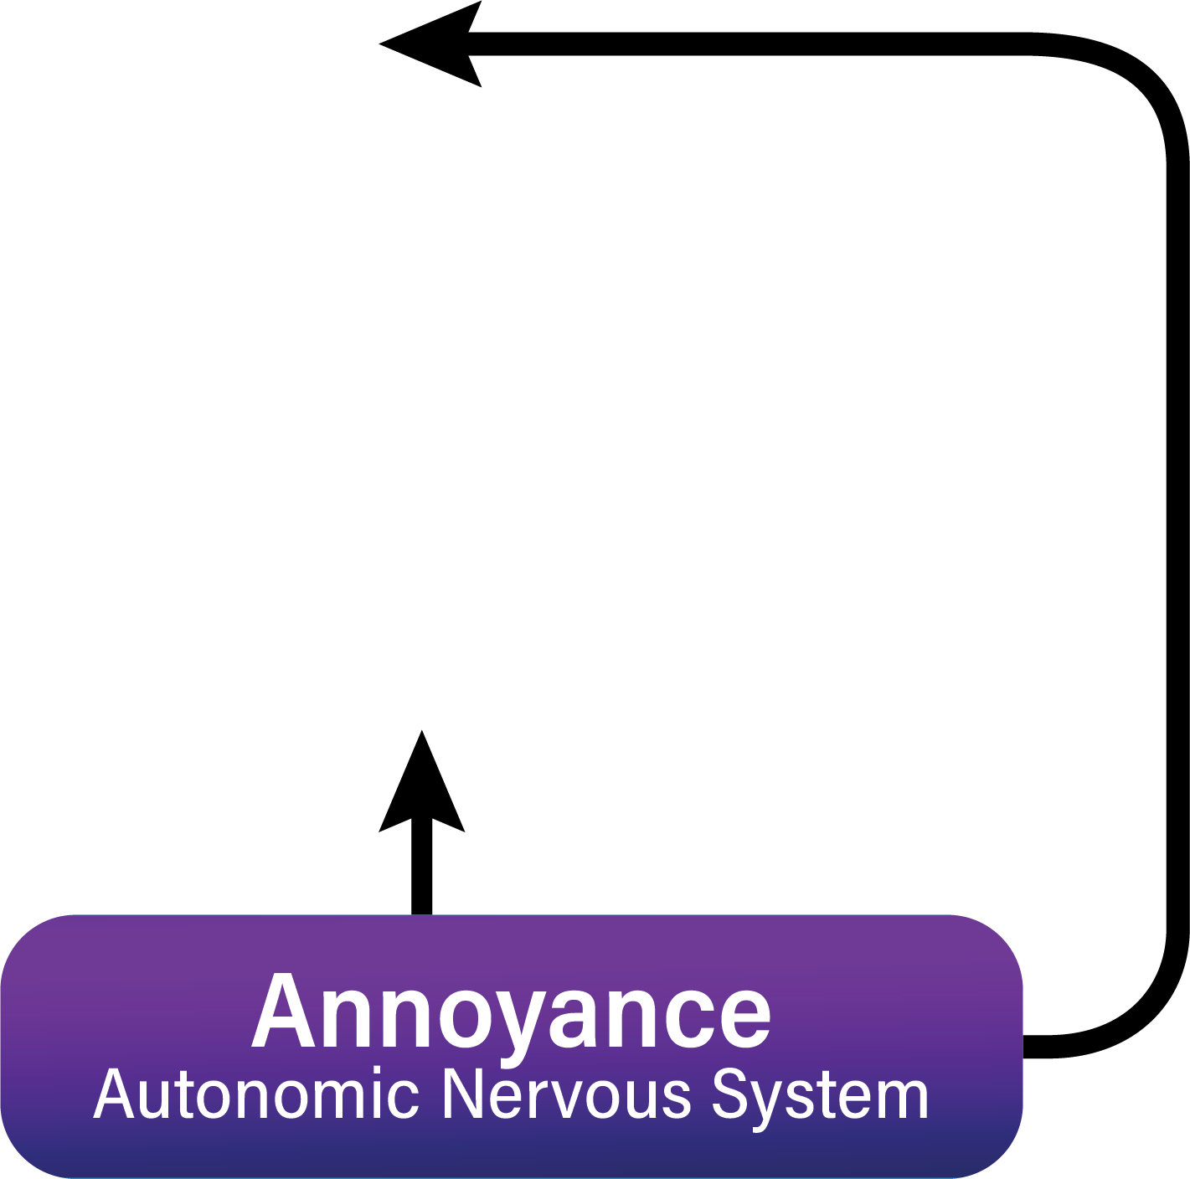
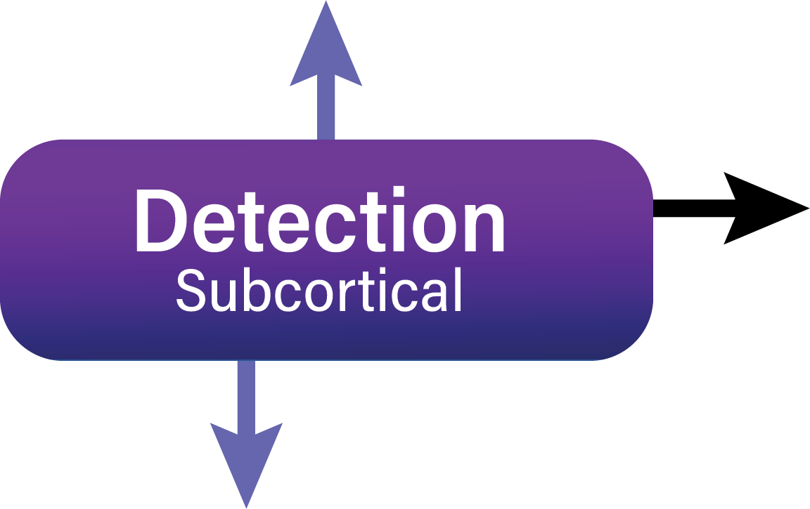
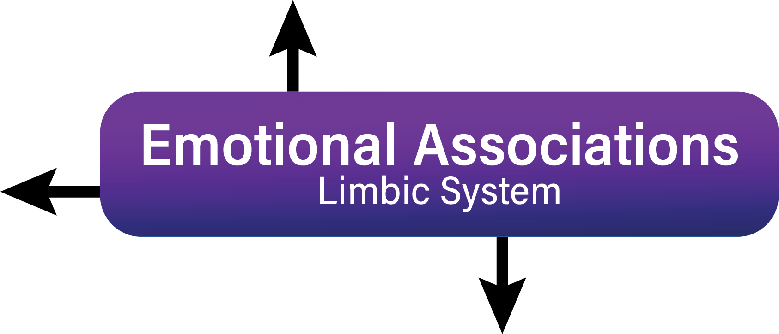

Slide 15
Habituation
Habituation is a decrease in response to a stimulus after repeated presentations. Or, as the American Psychological Association defines it, habituation involves "growing accustomed to a situation or stimulus," thereby diminishing its effectiveness.
https://www.verywellmind.com/what-is-habituation-2795233
The process of people or animals becoming used to something, so that they no longer find it unpleasant or think it is a threat
https://dictionary.cambridge.org/us/dictionary/english/habituation

Slide 18
Tinnitus treatments
Cognitive Behavioral Therapy and other counseling tools
Hearing Aids
Lenire and other tinnitus treatments

Slide 19
Programming demos
Likely reduced from full prescription unless long time wearer of devices
Start with pink noise slightly above audibility but not too loud that it becomes a distraction
Counsel on mixing point and comfort and soothing
Set expectations low as this will be a marathon process
Explain that tinnitus will do lots of things over the upcoming weeks as the brain starts to figure things out.
Strongly encourage consistent use and to keep the devices comfortable and soothing to start

Slide 21
What is Lenire?
Bimodal neuromodulation treatment
Controller- handheld device that controls the time and intensity of the treatment.
Headphones- plays a soothing sound with randomized tones in the soothing sound.
Tongue stimulator- uses a mild sensation on your tongue synched with the randomized tones in the headphones.

Slide 22
Lenire
71% of those with a moderate or worse tinnitus had a meaningful reduction in tinnitus severity with Lenire after 6-weeks when they had 6 weeks of audio-only therapy with minimal impact first.
83% of the 500+ participants across three successful clinical trials would recommend Lenire.
0 serious adverse side effects related to Lenire were reported
204 real world patient results closely match the clinical trial data.

Slide 23
Follow-up
30 min demo return appointment
Not expecting a miracle but do they feel motivated to wear the devices every day.
Lenire fitting
Prepare to have non device treatment options ready
DIY method
Counseling options

Slide 24
What to prepare
Stressed out individuals that have not had good answers so far. Minimal hope that we can do anything for them
Lots of questions you might not have answers to
Getting comfortable with people who cry
Knowing your limits
Establish your health care network
Neurology
Psychology
Physical therapy
TMJ specialists
Traumatic brain centers
ENT

Slide 25
Laboring tasks
Work Comp
Auto Claims
Medical Legal Opinions
Following up on questions
Seeing patients take longer than what to expect
Reports and communication with physicians

Slide 26
Why we do it
You can take a person who has not left their house in months because of fear to someone who can get back to their lives and give them confidence to manage their sounds
You can be someone who gets it for them
You provide a service to the community that no one else will do
People deserve the highest quality of life

Slide 27
Case #1 D.R. 2/9/2022
Male 63 years old
presents with a bilateral tinnitus described as a high-pitched sound mostly in his right ear following a waterskiing accident over 20 years ago
The tinnitus increased 2 days after his first dose of the Pfizer covid 19 vaccine.
Referred from ENT and has been ruled out for any retrocochlear concerns
Not getting sleep
Concentration is affected at work
Turned on sound generator in his hearing aids
TFI- 87 severe level
TRQ- 65 significant level
Aware 100% of his waking hours and bothered 100%
Notes:
Mayo clinic referral

Slide 28
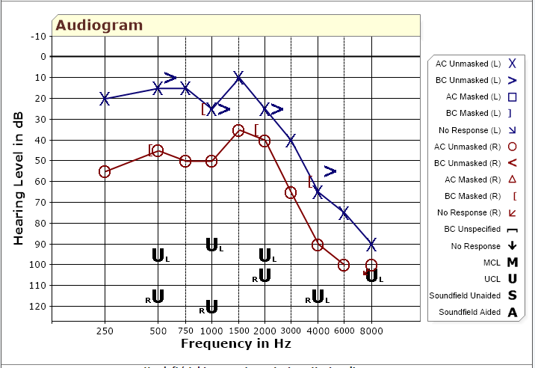
Case #1 DR

Slide 29
TRT- #1 6/2/2022
First 3 month follow up using his hearing aids with the sound generator turned on.
His tinnitus still consumes him most days. His concentration is affected which means his work is not getting the attention he is used to giving it.
He hasn’t been sleeping in the same room as his wife for 6 months for fear the sound machine would keep her up.
Started seeing a counselor on our recommendation
TFI now at 80, TRQ at 66
Evaluated his hearing aids via verifit 2 and determined he is significantly underfit. Counseled on making adjustments to his hearing aids at the next visit. (he wasn’t ready)

Slide 30
TRT- #2 9/15/22
He feels his devices are helping him with the noise on.
He is aware of his tinnitus but is in the process of accepting it. He has been working on his stress and fatigue as he is recognizing his tinnitus is most bothersome when he is tired.
He is still seeing his counselor and they are currently working on reducing his anxiety medication with a goal of removing it completely.
He wasn’t ready to up his hearing aids to targets just yet but did agree to creating a hearing aid only program for noisy restaurants where he doesn’t need the extra sound.
TFI at 62 TRQ at 24
Today was a good tinnitus day.

Slide 31
TRT#3 12/14/22
He thinks things are going ok but it is still noticeable.
He is still working with the counselor and has determined he has PTSD and working to get ADA accommodations.
He reports still in the acceptance stage with hopes it will get better.
We have adjusted to targets now for his hearing aids. He is complaining he isn’t hearing his wife as well anymore. We also ordered him a connect clip for one-on-one meetings
TFI at 72, TRQ at 49

Slide 32
TRT #4 3/15/23
He is reporting minimal change for him today.
He is managing his anger towards the sound much better.
He is willing to stay the course but he is not seeing the results he was hoping for.
Still doing counseling but also finds this to be hard to schedule and keep on right now.
TFI is 61 and TRQ at 38
Pt heard about a new tinnitus treatment coming up (Lenire) and was interested in trying it.

Slide 33
Transition to Lenire
5/2/23-Tested, fit and counseled on use.
TFI at 71 and TRQ at 43
5/18/23 First week follow up on use.
He reports hearing the lenire too much and learned turning it down made it very pleasant. He is noticing a “hangover” feeling for about a half hour after completing treatment.
His confidence is up and enjoys doing the treatment.

Slide 34
Lenire 6/21/23
In person check in.
He really looks forward to the treatment but does have some mixed results.
He has a hard time sitting still for a whole hour but can make it 30 minutes
He is starting to realize his low times aren’t as bad and he hasn’t had a break down in 6 months.
Still reducing anxiety medications
General outlook on life is much different.
TFI at 53 and TRQ at 38
He will keep doing the treatment and I have an appointment scheduled for next week to see where he is at.

Slide 35
Case #2 LP
57 year old male traveling in from out of state
Heard about Lenire and has been following it and wants it to fix his tinnitus.
Researches EVERYTHING!
Fit with Lenire and counseled on use and he stayed after to listen to our tinnitus seminar where we address the Neurophysiologic Model of tinnitus.
TFI 73 TRQ at 74
In the next day to readjust his tongue stimulator as he thought it wasn’t strong enough. New calibration shows same settings as before.
Hx of throat cancer with chemotherapy and radiation about 10 years ago.
Hx of noise exposure- owns a landscaping business.
Son just recently went through some addiction issues and he is helping him get on his feet again.

Slide 36
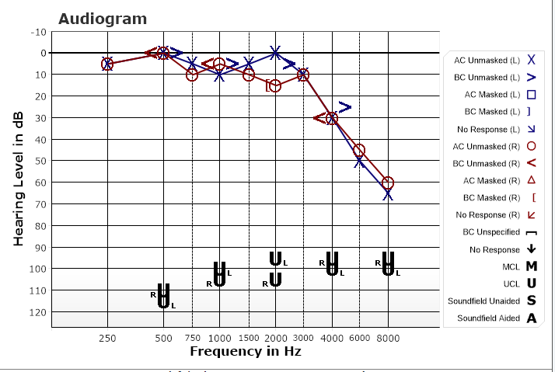
Case 2# LP

Slide 37
5/16/23
He has gone from bad to worse. He reports mostly his stress/anxiety and depression is getting worse. His tinnitus has spiked.
Scheduled appointment with a counselor
Stopped using the device
Needs to focus on getting his anxiety under control before going back to Lenire treatment

Slide 38
5/25/23
Phone call appointment
Started CBT and has had 2 appointments so far.
His tinnitus is good in the morning and ramps up throughout the day and by night fall it is almost unbearable.
He has a local audiologist and started up on a TRT protocol with Widex Moment hearing devices using several different zen programs.
Doing both Lenire and TRT is not recommended by Lenire due to the intensity of treatment with Lenire.
Constantly doing research and has joined several tinnitus facebook groups- one dedicated to consumers with Lenire.
Still not doing Lenire treatment due to fear it will continue to make his tinnitus worse.
Mailed his device back for adjustments to the tongue stimulation and we will ship it back.

Slide 39
8/1/23
Called Pt.
He is starting to accept things a little.
Went on vacation to his brother’s house in Florida
Still not doing Lenire treatment after confirmation the device is working correctly and at a softer level on the tongue stimulation.
Still using his hearing aids

Slide 40
8/23/23
Follow up call-
Still no reduction in his spike
Constantly checking in on his tinnitus to see what makes it change and not getting any consistency to rule things out.
Starting to have thoughts of suicide just because he isn’t seeing any hope it will get better.
We talked about his history of when it started and the spike being traumatic and maybe starting EMDR therapy would be beneficial.
Recommended he start scheduling time to think about his tinnitus so he can give his brain a break from constant thoughts.

Slide 41
8/28/23
Call with his wife on the phone as well. I saw a post on the Lenire support FB group of him going to the ER on Friday and he was very frustrated.
Lots of questions about the TENT A-3 study and what the outcomes were of those who had a spike.
Discussed starting back with Lenire but doing a tapered or gradual treatment protocol and recommended we see him in person again.
Scheduled a week in Minnesota so we can work with him multiple times within the week.

Slide 42
9/5/23
Back in office today. Reviewed is journey since he was fit and the ups and downs (mainly downs) he has had since then.
Talked about the Facebook groups he belongs to and the theory of negative counseling.
He finds comfort in helping people on the group but in the meantime, he is still feeling bad about his own tinnitus.
Reviewed the neurophysiologic model of tinnitus.
Hearing evaluation completed and UCLs. There is consistent results from when he started.
Verification of his Widex devices showed they were underfit in the high frequencies.
Recalibrated his Lenire with sound volume down and background noise down. He reports comfort in office.
TFI at 84 and TRQ at 93.

Slide 43
9/6/23
He gets a headache after starting the treatment and feels a spike coming up.
He did not sleep well last night.
Counseled strongly on the feedback loop and his natural anticipation of it being bad so his anxiety will be up.
Again, focused heavily on getting him to stop connecting to Facebook groups and the Tinnitus Talk forum.
He will do 15-minute sessions instead of 30-minute sessions.

Slide 44
9/7/23
He still didn’t sleep well but his spirits are up. He knows he has a plan.
Turned his hearing aids down slightly in the highs as they were just a little too high and removed the zen tones so he only hears zen noise for habituation purposes.
Decided on 15-minute sessions and to have faith in the process. His wife is very supportive and helpful to remind him that consistency is key.
Focused on Habituation of the treatment is first then habituation of the tinnitus.
Put him back in the booth and did pitch and loudness match of his tinnitus. 8k tonal pitch with 4dB SL tinnitus volume.

Slide 45
References
Fagelson M. Tinnitus Education for Audiologists Is a Ship at Sea: Is It Coming or Going? Audiol Res. 2023 May 25;13(3):389-397. doi: 10.3390/audiolres13030034. PMID: 37366680; PMCID: PMC10294936.
ATA.org
Kroenke K, Wu J, Yu Z, Bair MJ, Kean J, Stump T, Monahan PO. Patient Health Questionnaire Anxiety and Depression Scale: Initial Validation in Three Clinical Trials. Psychosom Med. 2016 Jul-Aug;78(6):716-27. doi: 10.1097/PSY.0000000000000322. PMID: 27187854; PMCID: PMC4927366.
Dorsal cochlear nucleus hyperactivity and tinnitus: Are ... - asha wire (no date). Available at: https://pubs.asha.org/doi/full/10.1044/1059-0889%282008/08-0004%29 (Accessed: April 3, 2023).

Slide 46
Day in the life of a tinnitus specialist
Jason Leyendecker, AuD

