Slide 1
Simulated audiometry: Overview and promising applications
Ice breakers: I easily accept and adopt new technologies and ideas! (TRUE or FALSE)
What’s something that presenters do that bothers you?
How were you taught audiometry? How did you learn audiometry?
Shae D. Morgan, PhD, AuD, CCC-A, FAA
Associate Professor; Director – Program in Audiology
University of Louisville
Co-owner
Audiology Technology Solutions, LLC, creators of Theta

Slide 2
Disclosures
Associate Professor at the University of Louisville
Co-owner of Audiology Technology Solutions, LLC which owns the Theta Audiology Simulator
Theta developer/programmer
Invited HAA speaker – registration, honorarium
Ping-pong player, tinkerer, rock climber, dad

Slide 3
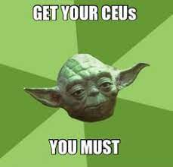
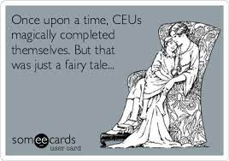

Slide 4
Who is this talk for?
Everyone
Notes:
Education is happening all the time (in clinic too!) so simulation can help in all of these cases.

Slide 5
Learning Objectives
Learners will be able to discuss different kinds of audiometry simulators
Learners will be able to assess implementation of simulation for educational/learning experiences
Learners will be able to highlight applications for simulated audiometry in clinical practices

Slide 6
Overview:
Introduction to simulators and audiometry simulation
Using simulation to teach
Using simulation in your clinical practice
Wrap-up/summary

Slide 7
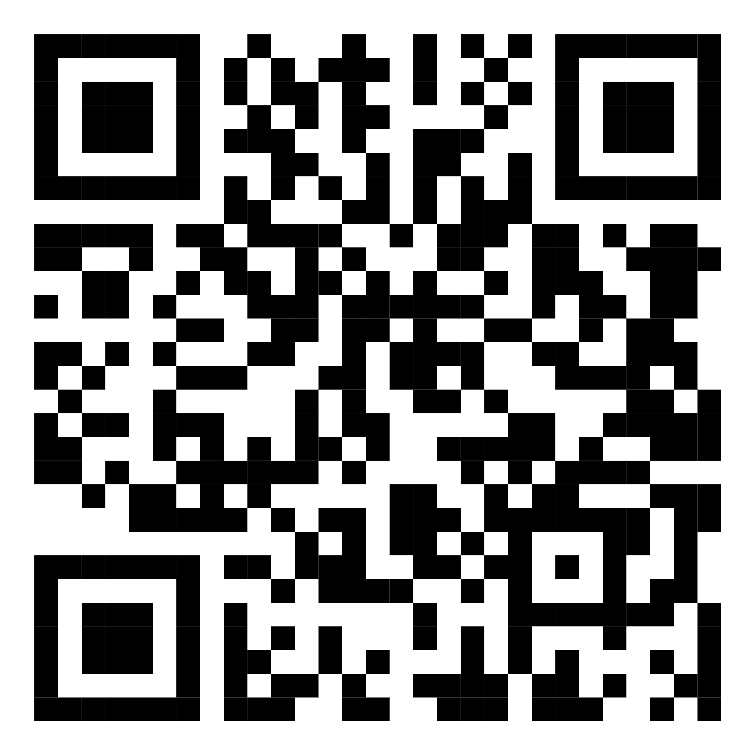
Audiogram of the Day audiologysimulator.com click “audiogram of the day”

Slide 8
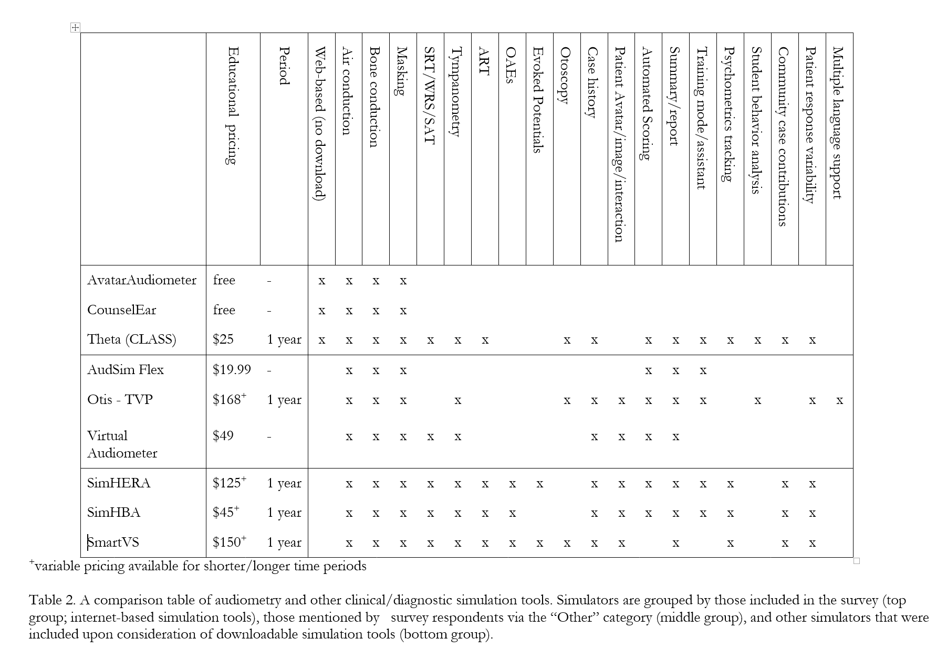
Audsim.com Otis the virtual patient SimHBA/SimHERA CounselEAR audioCARL
Svec, A., & Morgan, S. D. (2022). Virtual audiology education tools: A survey of faculty, graduate students, and undergraduate students. The Journal of the Acoustical Society of America, 151(5), 3234-3238.

Slide 9
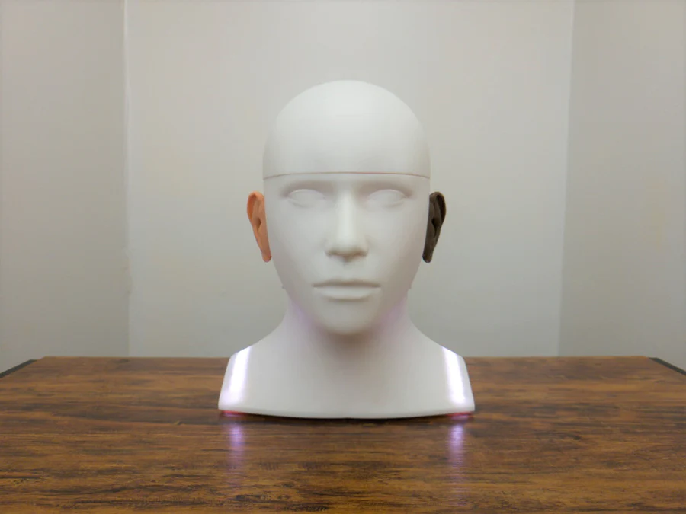
Audsim.com Otis the virtual patient SimHBA/SimHERA CounselEAR audioCARL
AudioCARL

Slide 10
Introduction to Theta
https://audiologysimulator.com

Slide 11
Theta Overview topics:
Home page/login
Designer
Show all elements
Audiogram
Save picture
Split audiogram
Overlays
Practice/exam fixed/template
Assess
Explore
Settings and realism
Submissions/Report
Resources

Slide 13
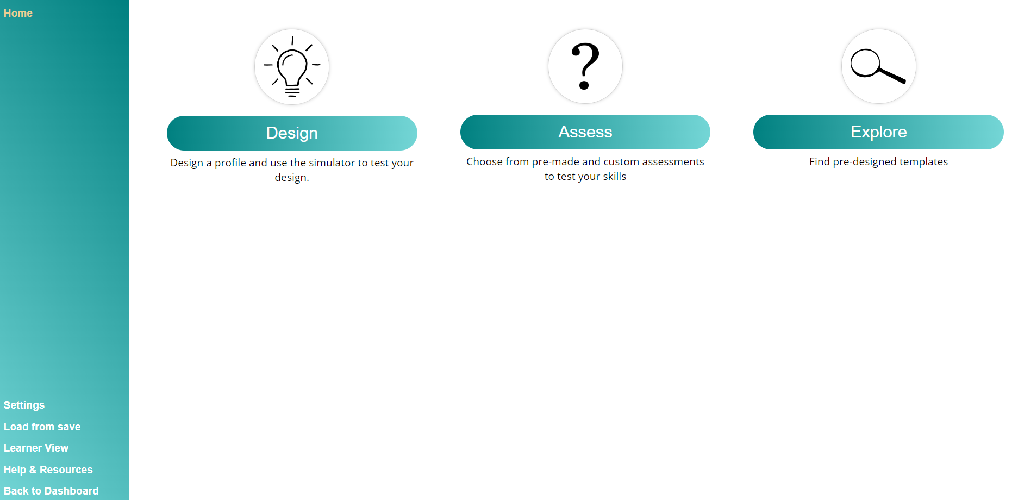

Slide 14
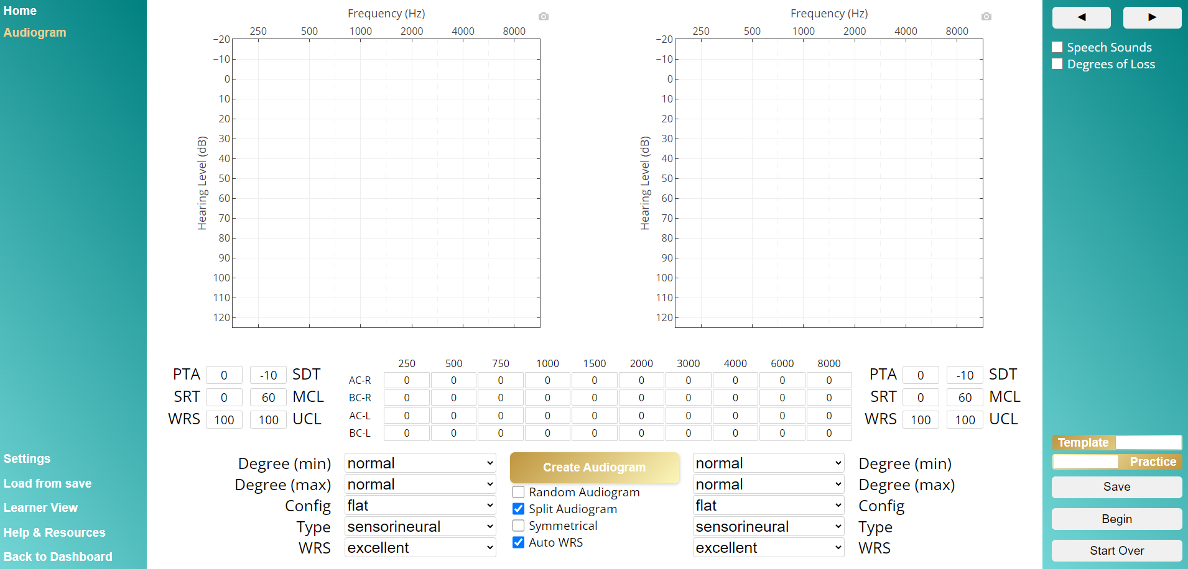

Slide 15
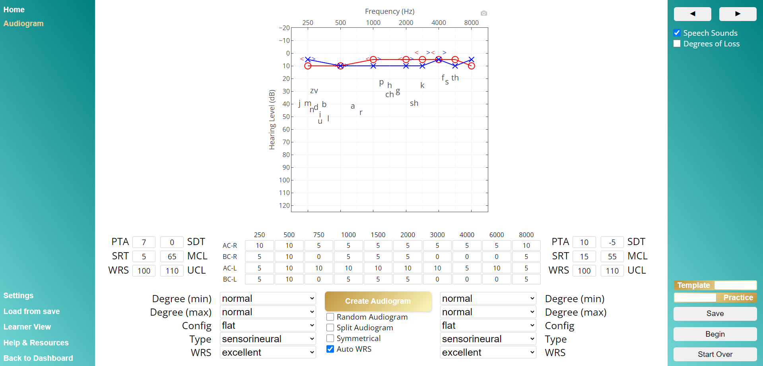

Slide 16
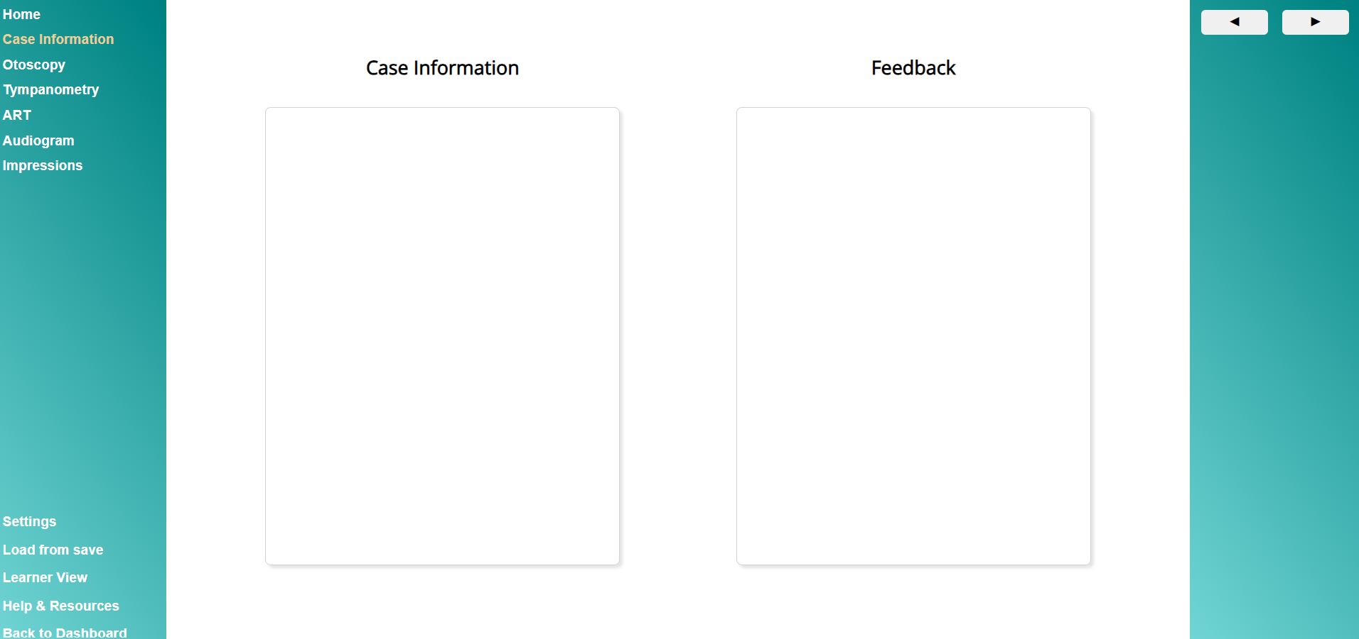
Notes:
This element is pretty straightforward – you can provide a case history, or leave it blank and ask the student to create a case history that fits the profile you give them. This way you can assess the students understanding of what symptoms, primary complaints, and so forth are commonly associated with a given hearing loss profile.

Slide 17
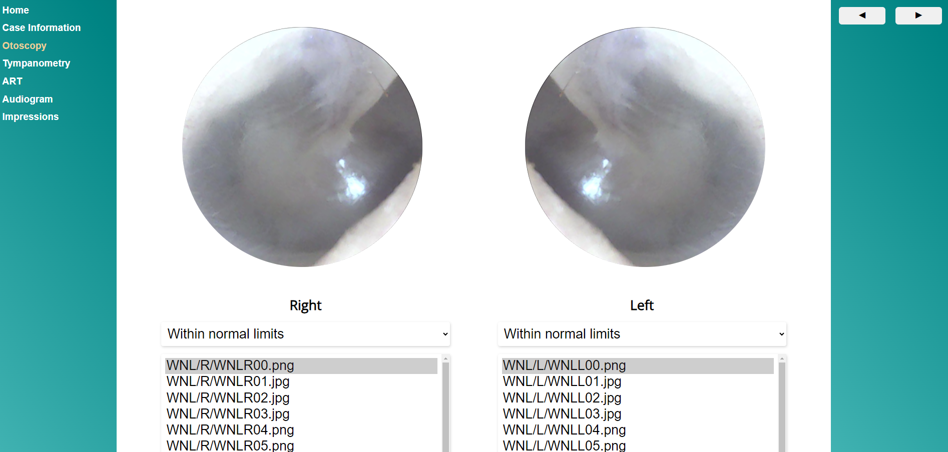
Notes:
Next is the otoscopy module. CLASS has a built in bank of otoscopy images for all sorts of conditions, including perforations, cholesteatomas, glomus tumors, tympanosclerosis, otitis media with effusion, acute otitis media, tubes, tympanoplasty, partially and fully occluding cerumen and within normal limits.
Shameless plug – we’d LOVE to get more photos in this bank. If you have images you’re willing to release a copy of for use in the simulator – PLEASE EMAIL ME. In particular, we’re looking for images of individuals with different skin tones to have a more diverse database!

Slide 18
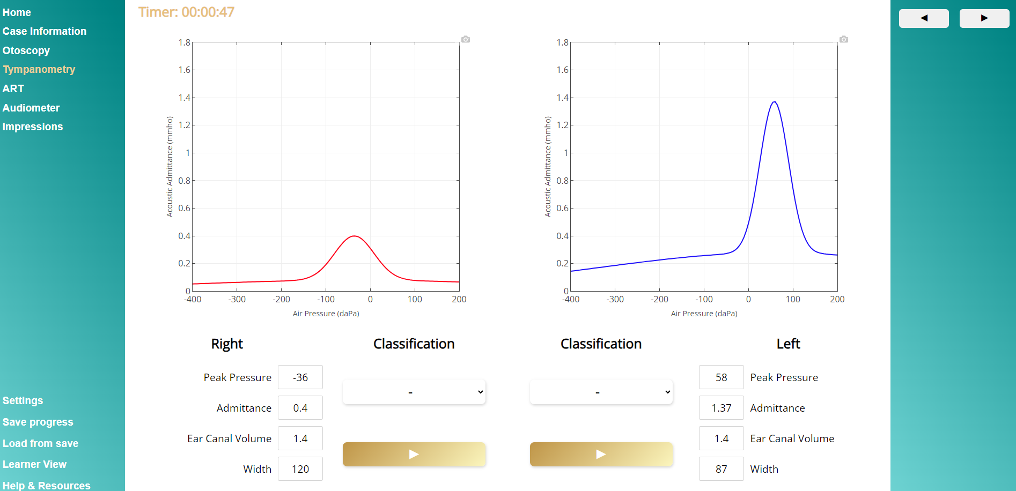
Notes:
The Immittance element includes tympanometry and acoustic reflex thresholds. CLASS anticipates supporting reflex decay and a basic WAI simulation in future versions. In the tympanometry designer, users select the type of tympanogram they would like for their case. During an assessment, tymps draw from right to left, just like they do in the clinic, and the normative range box is only visible in practice mode. In test mode, students have to determine for themselves if the tymp is within normal limits or not and what type of tymp it is

Slide 19
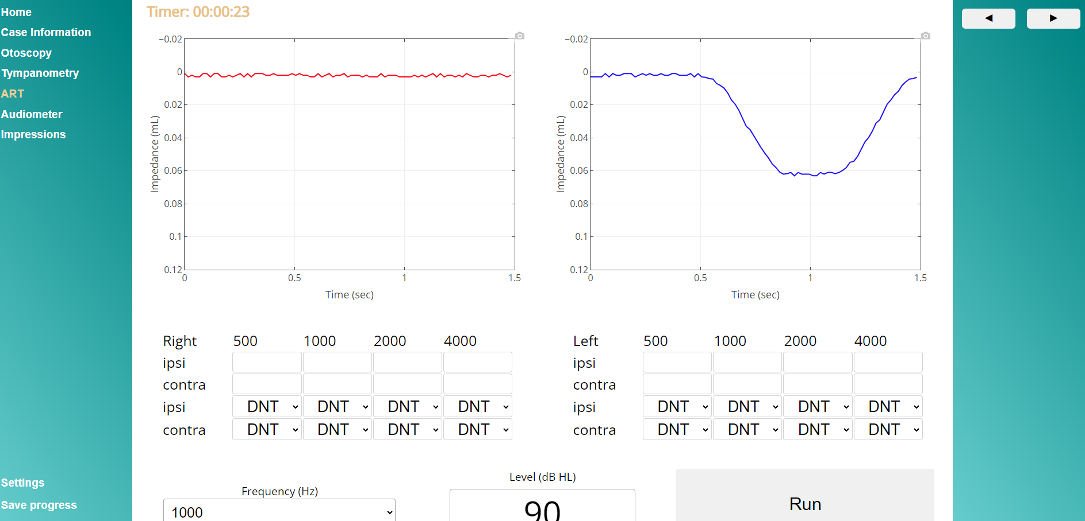
Notes:
Acoustic reflex thresholds are automatically estimated based on the designed audiogram, but can be modified here. Both ipsilateral and contralateral reflexes can be tested, and the program supports the primary patterns of reflexes depending on the level of the bone conduction threshold (to determine recruitment) and any air-bone gaps (indicating a conductive component). Users can run the art at different levels and the magnitude of the reflex will change depending on the level relative to the true threshold.

Slide 20
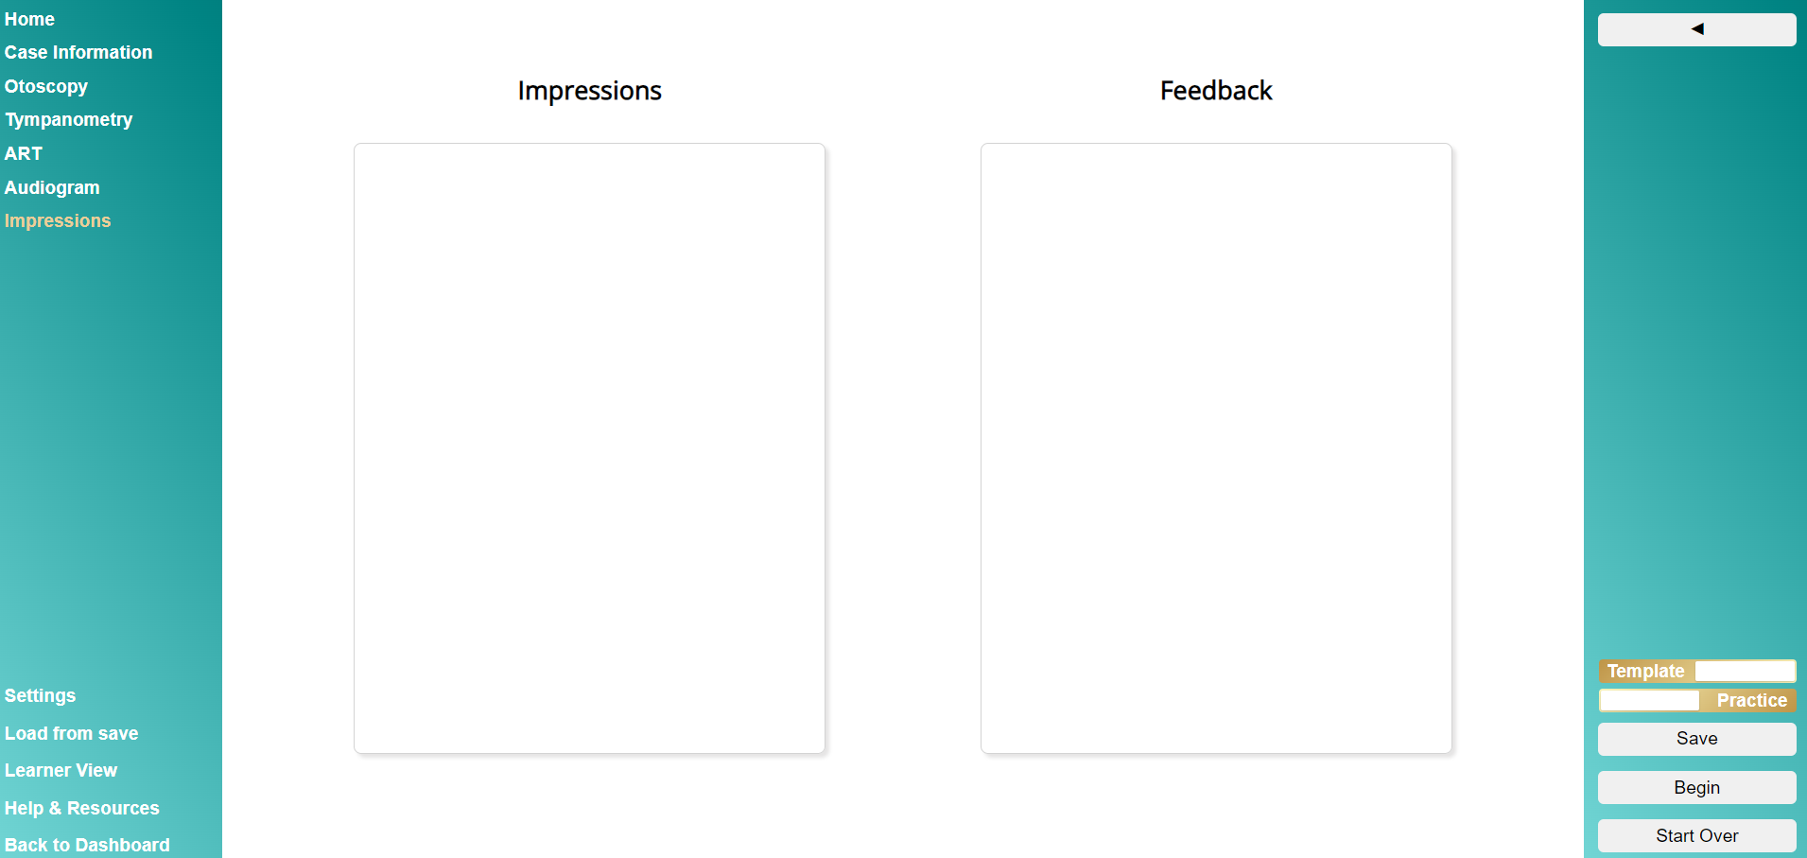
Notes:
The impressions/report section provides a space for users to leave their impressions about the case or to provide a full written report. This is a great place to have students debrief their assessment, ask questions, and provide feedback that you can use during your debriefing session.

Slide 21
Settings and realism
https://audiologysimulator.com

Slide 22
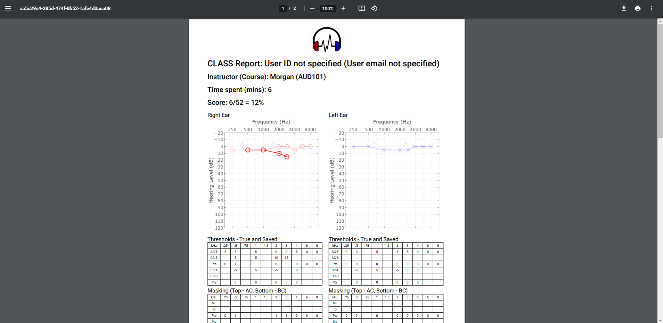
Notes:
When you complete a case, the program automatically scores the case elements and creates a PDF summary report of your performance. This report provides users with immediate feedback on the case they just completed

Slide 23
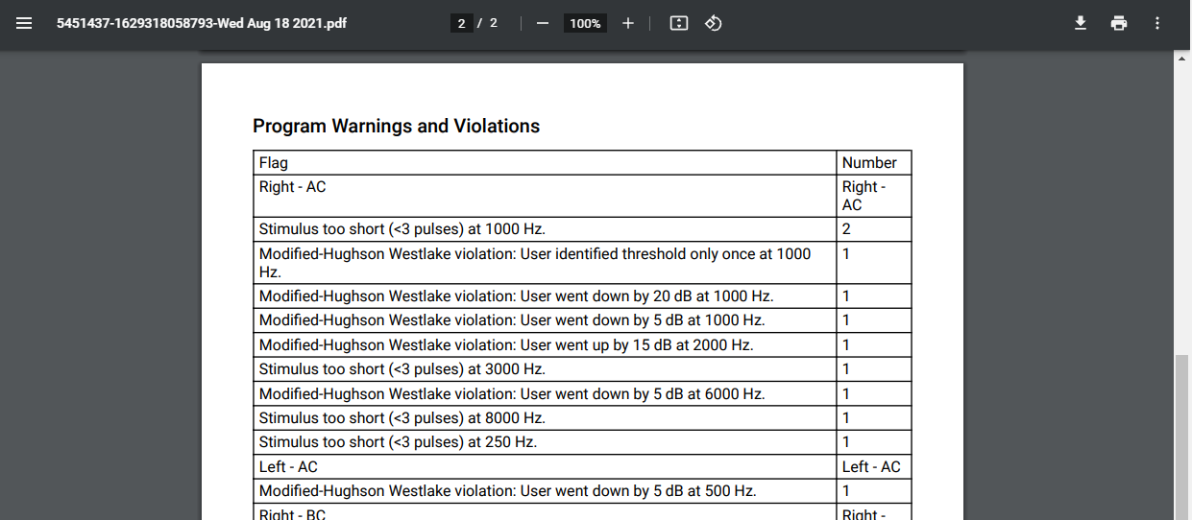
Notes:
One really neat feature of CLASS is an automated analysis of user behaviors. The program tracks each threshold presentation and has certain flags that get created when a user does not appropriately perform the tests. In this example, we can learn that the user did not follow the Hughson Westlake procedure because they went up and down by intervals other than 5 and 10 dB. They also didn’t hold down the stimulus presentation button for long enough (~1 second) and they didn’t confirm their threshold measurement at 1000 Hz in the right ear via air conduction. These flags give users and instructors feedback on how they can improve their technique to follow best practices. There are currently around 20 flags that get analyzed for each ear, transducer, and frequency on every submission.
and a copy of every report is stored on the cloud in an instructor portal - so it’s important to make sure you’re registered for the right instructor before you complete a submission.

Slide 24
Using simulation to teach

Slide 25
Overview
Clinical Simulation
Build clinical confidence
Training and remediation

Slide 26
What is Clinical Simulation:
Standardized Patients
Simulation technologies
virtual patients
digitized mannequins
immersive reality
task trainers
computer-based interactive
What it is NOT:
Lab activities
Observational experiences (i.e., video clips, watching live or recorded sessions)
https://www.asha.org/certification/certification-standards-for-aud-clinical-simulation/

Slide 27
Computer-based Simulations
ASHA Guidelines/requirements:
Supervision does not need to be synchronous!
Monitor time spent in a session (use an average, or track via the program)
Group work is treated the same as in traditional clinic
Clinical hours can only be counted one time per unique simulation case.
25% observation requirement (via some debrief or direct supervision)
Notes:
Clinical instruction occurs asynchronously followed by debriefing sessions.
If working on the same CS case, treat it like a group clinical situation.
Asynchronous learning task would be a good approach.

Slide 28
Example simulation lesson plan
Instruction/lecture and supplement:
Presentation of new material
Assignment of a clinical simulation activity
Completion of the clinical simulation activity
Debriefing exercise

Slide 29
Alternative simulation lesson plan
Experiential learning:
Assignment of a clinical simulation activity
Completion of the clinical simulation activity
Debriefing exercise
Presentation of new material

Slide 30
Debriefing activities
Activities may include:
Face-to-face discussion,
Self-reflection with feedback,
Written self-evaluation with feedback

Slide 31
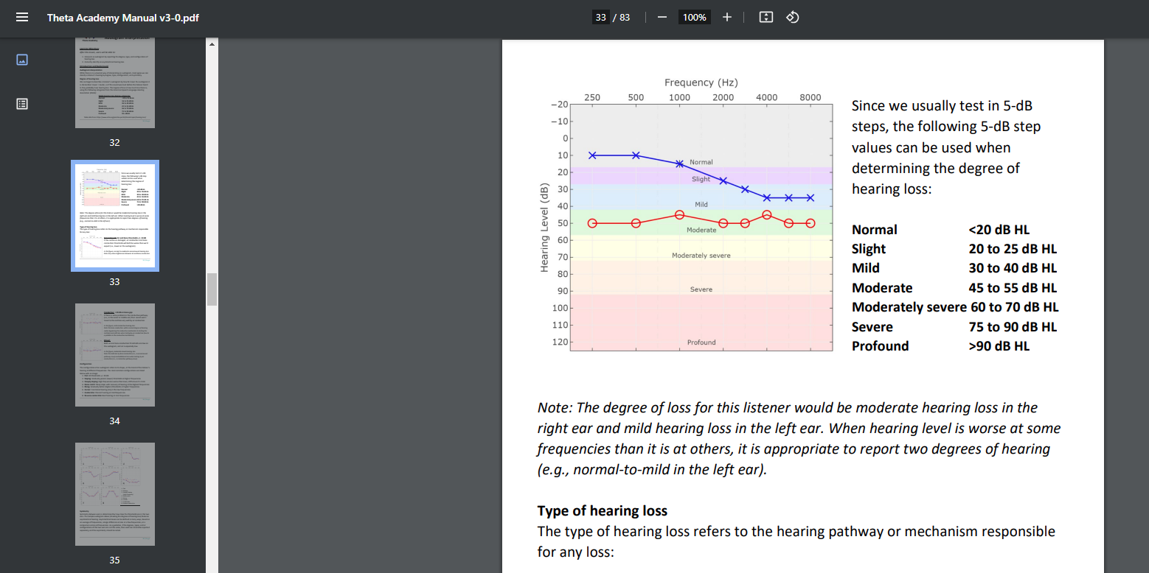
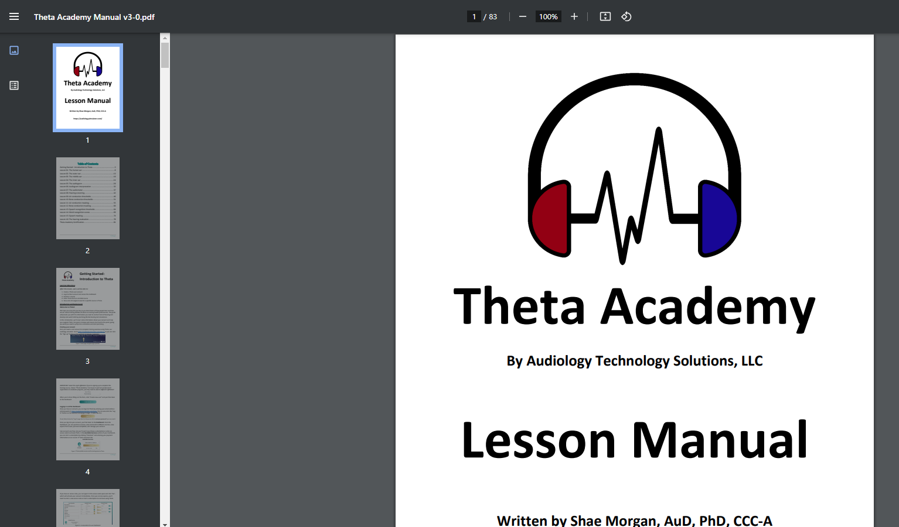
Theta Academy

Slide 32
What’s one audiometry concept that you try to understand/teach?

Slide 33
Theta Concepts and Masking Demo

Slide 35
Notes:
My personal favorite is the masking tool. This tool is available only for instructors (since it gives away some of the case information when it’s used). This is a rather unique perspective to teaching masking, but I have found it personally to be very helpful. The masking tool shows the level of the signal (in gold) and the level of the masker (in gray) in the test ear (left) and nontest ear (right). The appropriate thresholds are marked, and any occlusion effect value is also denoted in the non-test ear (during bone conduction masking). The masking tool shows users why the patient stops responding in a simple way, using a bar graph that shows when the signal has crossed over (needing more masking ) or when the masker has crossed back (demonstrating over masking).

Slide 36
Using simulation in your clinical practice

Slide 37
Applicant review

Slide 38
Takes 45 minutes
Resumes all look excellent
Can’t mask
Follows best practices
Doesn’t familiarize SRT

Slide 39
Provider evaluations/verification

Slide 40
Individual performance analysis
View threshold searches
Check masker levels
Check SRT and WRS testing procedures
Examine flags

Slide 41
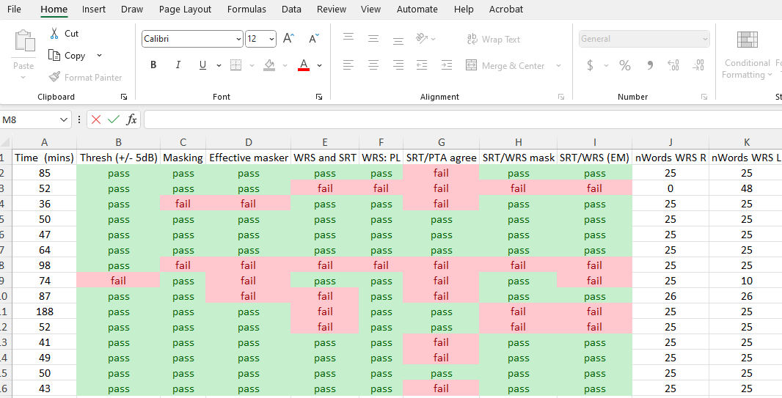

Slide 42
Theta SimuHear Demo

Slide 43
Limitations and Wrapping up

Slide 44
Simulation does not replace real-world training!!

Slide 45
Summary
There are many options out there for clinical simulation
Audiometry simulation mimics real-world listeners, and a variety of simulators exist
Audiometry simulation and analysis can help your practice recruit candidates, evaluate providers, and identify targeted remediation
I’m happy to answer any questions regarding clinical simulation or Theta!
UofL: shae.morgan@louisville.edu Theta: audiologysimulator@gmail.com
Notes:
In summary – there are SO many ways you can use this new web-based simulation tool for audiology testing.

