Slide 1
Rescue AuD
Audiology Extenders are Heroes
Dr. Liz Rogers
Kentucky Academy of Audiology 2023

Slide 2
Disclosures
None.

Slide 3
Learner Outcomes
Learner Outcome #1: Learn how extenders can help increase your patient load, without increasing your administrative load.
Learner Outcome #2: Learn the scope of practice for extenders in Kentucky.
Learner Outcome #3: Learn how to find and hire the right extender for you.
Notes:
How many of you are using assistants now?

Slide 4
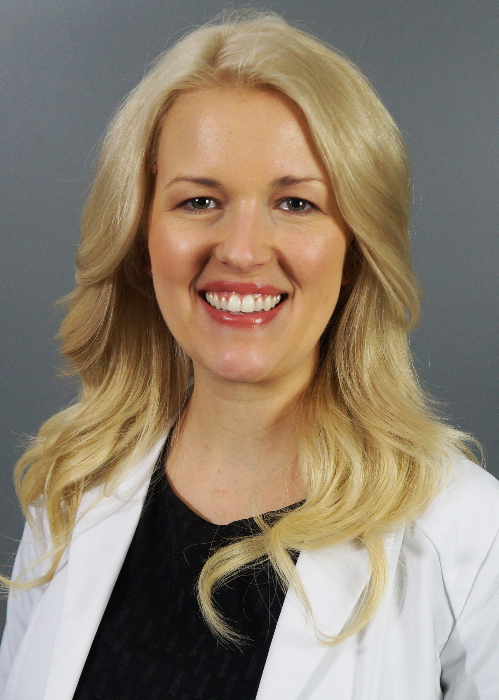
Dr. Liz Rogers
Graduate of Indiana University-Bloomington for BA and AuD
Owner of Southeast Kentucky Audiology in Corbin since 2017
Special interests include rural healthcare, cochlear implants, and wax removal!

Slide 5
Southeast Kentucky Audiology
Services
Two Locations: Corbin and Somerset
ABR/ASSR
Hearing Evaluations
  VRA/CPA, Tymps, Reflexes, OAEs, Standard, High frequency
Cerumen Management
  Earigator, Manual Tools, Suction
Balance Evaluations
  VNG, Calorics, Rotary Chair, cVEMP/oVEMP, SOP, DVAT
Hearing Aids
  Selection, Fitting, REM, Programming, Cleaning, Repairs, All Manufacturers
Cochlear Implants
  Candidacy Evaluations, Counseling, Activation, Programming, Speech Perception Testing, All Manufacturers

Slide 6
Southeast Kentucky Audiology
Our Dedicated Team
Our Team
  Two Audiologists (2014, 2016)
  Hearing Instrument Specialist (2003)
  Fourth Year Extern
  Office Manager (2017)
  Hearing Aid Technician (2018)
  Two Audiology/Provider Assistants (2021)
  Physician Liaison (2018)
  Three Patient Care Coordinators
  Speech Language Pathologist (2023)
  Ear, Nose, and Throat Specialist (2023)
  And Growing!

Slide 7
Allied Health Professionals Using Assistants
Speech Language Pathologist
Dentist
Physical Therapist
Nurse Practitioner
Chiropractor
Podiatrist
Optometrist
Occupational Therapist
Veterinarian
Notes:
Why is this common practice for our allied health professionals, and not us?

Slide 8
Audiologist Scope and Responsibilities
Vestibular
Electrophysiology
Cochlear Implants
Auditory Processing Disorder
Tinnitus Management
Cerumen Management
Hearing Evaluations
Hearing Aids
Accessories
Meetings
Trainings
Report Writing
Phone Calls
New Device Orders
Device Repair Orders
Device Check Ins
Marketing
Administrative/Clinic Duties
Clinic Projects
Notes:
Administrative and clinic duties may include cleaning equipment, ordering and restocking supplies, organizing supplies,
Projects may include writing new protocols, developing new systems.
And we are supposed to do all these things in less than 50 hours a week.
I am sure some of your clinics have had discussions on how to see more patients because reimbursement is stagnant or shrinking, and the cost of everything has gone up. Your clinic needs to diversify by adding specialty services, but how are you supposed to do that when your schedule is already booked out for several weeks?
You may already be seeing upwards of 20 patients a day, depending on your setting and timing of appointments.

Slide 9
Burnout Is Real
Burnout: A sense of exhaustion caused by constantly feeling swamped
Burnout leads to:
  Reduced productivity and revenue
  Turnover
  Mental health concerns
What causes audiologists/providers to burn out?
Notes:
What causes us to feel burnt out?
Patient load
Administrative load
Not supported at work – poor work environment, higher ups aren’t listening, only looking at the bottom line, etc

Slide 10
Audiology is Shrinking
Our profession is shrinking
  Not enough new audiologists entering our profession
  Attrition
  Retiring
The need for audiology is growing
  Aging population
  Spotlight on hearing loss and cognitive decline
  Increased awareness

Slide 11
Audiology Needs Rescuing
Extenders are the answer!
Extender (medical definition): non-medical healthcare provider who sees patients on behalf of or in conjunction with a lead physician.
How can we apply this concept to audiology?

Slide 12
Extenders
Hearing Aid Technician
Hearing Instrument Specialist
Audiology/Provider Assistant
Notes:
These are in the order I believe most offices are using them in.
Talk about the difference between tech and assistant.
Why and how we developed our model

Slide 13
Hearing Aid Technician
Scope of practice
  Hearing aid cleanings
  Hearing aid orders
  Hearing aid repairs
  Hearing aid check ins
  Electroacoustic analysis
  Firmware updates
  Bluetooth pairing/troubleshooting
  Setting up hearing aid fittings
  Otoscopy
Training
  Informal or formal
  Can double as your PCC

Slide 14
Hearing Instrument Specialist
Scope of practice
  Otoscopy
  Hearing tests
  Ear mold impressions
  Hearing aid consultations, fittings, orientations, programming, troubleshooting
  Accessories
  Cerumen management
Training
  Formal one year apprenticeship
  Pass KY HIS licensure exam

Slide 15
Audiology/Provider Assistant
Scope of practice
  Everything a HA Tech can do plus
  Hearing aid orientations
  Patient paperwork
  Accessories
  Phone calls
  Marketing
  Projects
  Help manage provider’s schedule
  Report writing/scribing***
Training
  Informal or formal
Notes:
As assistant is your right hand during the day. They are helping you with patient flow as well as administrative tasks.
Share Saturday morning story with scribing. Report writing/charting was a large part of our providers’ burnout.

Slide 16
Extender Cautions
Cerumen management (Tech/Asst)
Ear mold impressions (Tech/Asst)
New/follow-up hearing aid programming (Tech/Asst)
Hearing tests/diagnostics (Tech/Asst/HIS)

Slide 17
Qualifications
Highly organized
Excellent writing skills
Friendly and comfortable working with people
Ideally has a background in a medical office
Bonus if they have a history of being a medical assistant, veterinary technician, etc
A desire to help others/improve quality of life - Passion
A desire to advance their career
Notes:
Being organized, helps you be efficient. If you are efficient, you are saving time, if you have more time, you can see more patients, more patients is high revenue, etc..

Slide 18
Example
Without assistants, scheduling hearing evaluations for 1 hour, we could see up to 7 new hearing evaluations in one day. Built-in 1 hour of paperwork time per day
With assistants, scheduling hearing evaluations for 45 minutes, first 15 is with assistant, we can see up to 15 new hearing evaluations in one day
Notes:
Share your story on how we started using assistants

Slide 19
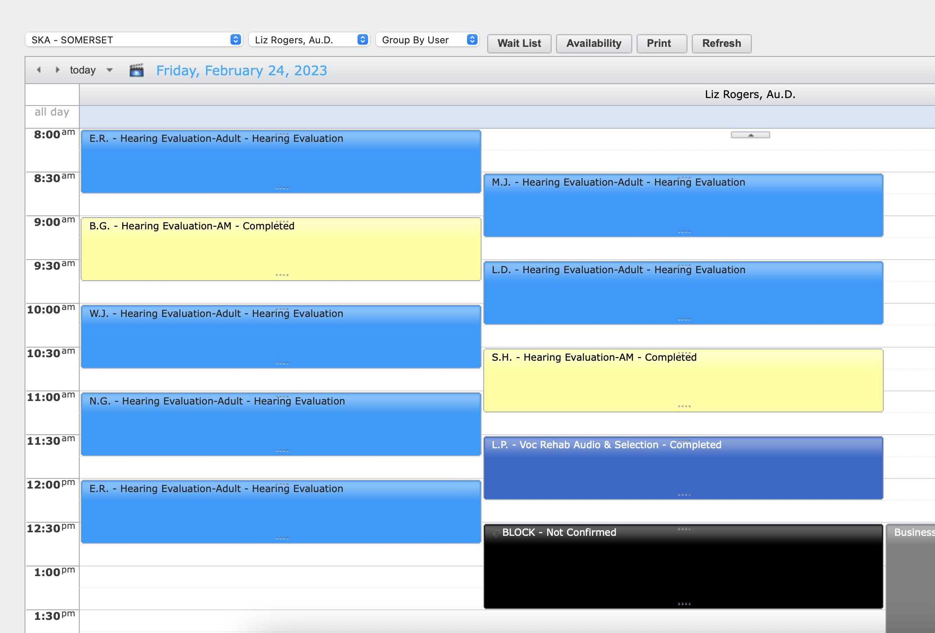
Example

Slide 20
Example
Audiologist hired an technician, provided formal (webinars) and informal (in office) training
Audiologist was freed up to perform higher level appointments
Technician had 21 patient facing hours in August. This utilized only 34% of her available hours. She has the capacity to do 61 hours. She generates on average $188 per hour, and generated $4,100 in August
Audiologist generates on average $464 per hour. Using a technician allowed the audiologist to potentially generate $9,744 more in August
If the technician was booked the full 61 hours every month - she could generate $137,616 a year, which then frees the audiologist to generate an extra $339,648 a year
Notes:
This is the example you can use to convince your managers, bosses, etc on how hiring an extender can help generate more revenue.

Slide 21
Increase Patient Load, Increase Revenue, AND Reduce Burnout
Extenders allow us to to help more patients in a single day
Extenders allow us to practice to the top of our scope, as desired
Extenders take appointments off your caseload and open it up for more specialized and higher revenue generating appointments
Extenders allow us to increase sales in a single day – more diagnostics, hearing aids, batteries, receivers, wax guards, warranties, HA supplies
Extenders reduce your administrative load
Extenders reduce the amount of knowledge you must remember
Extenders reduce burnout by helping you feel less swamped
https://www.instagram.com/reel/CnUINyIBXbZ/?igshid=MTc4MmM1YmI2Ng%3D%3D

Slide 22
Thank you!
Questions?
Email: dr.rogers@sekyaudiology.com
Phone: 606-528-9993

